Slide 1




Going to Playgroup

Slide 2
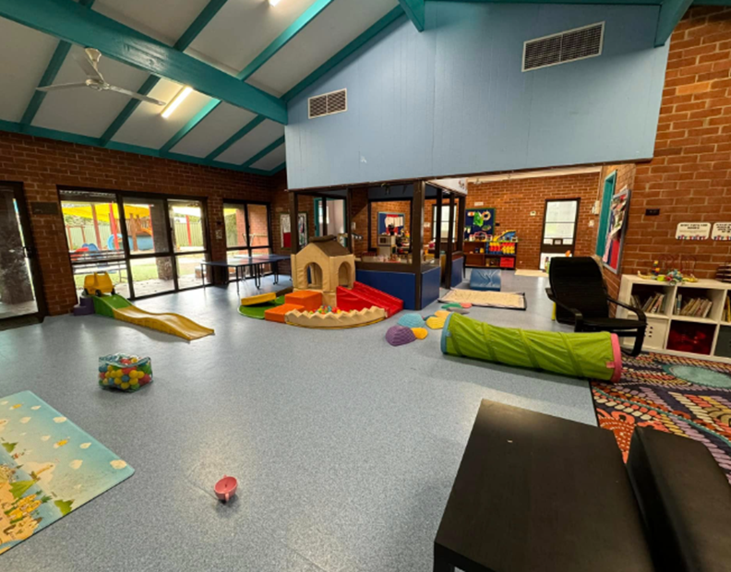

Add photo of your playgroup venue
On [insert day] I am going to the
[insert name] Playgroup.

Slide 3
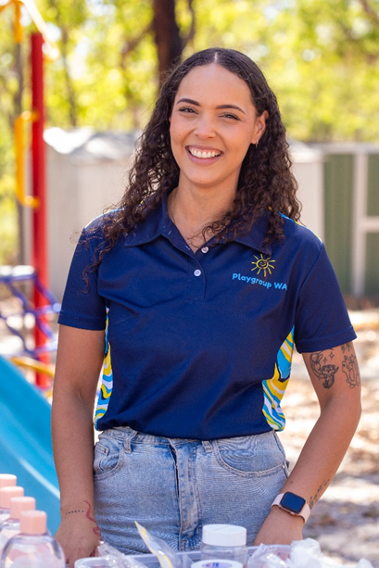
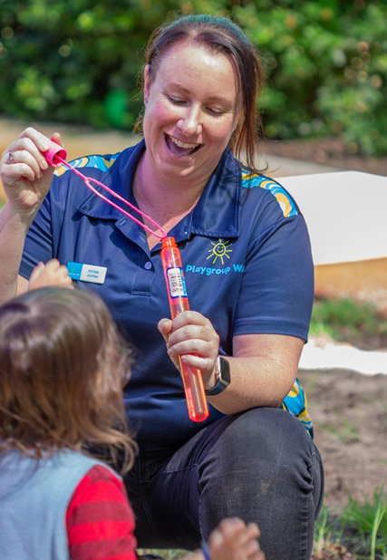
Add photo of committee members
[name]
[name]
Some of the people I might see at playgroup are
[insert name of committee members/regular attendees]

Slide 4


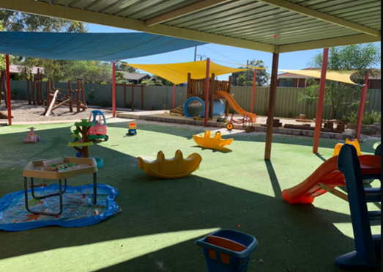


Add photo of activities / outdoor area if applicable
There are lots of fun activities for me to do at playgroup. I can [insert activities eg: play with playdoh, do some craft, play with toys or play outside]

Slide 5
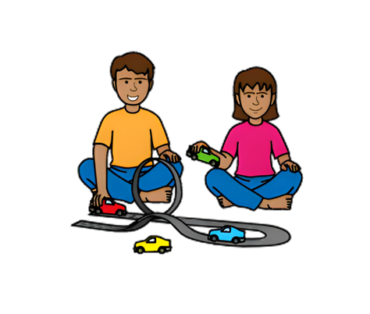

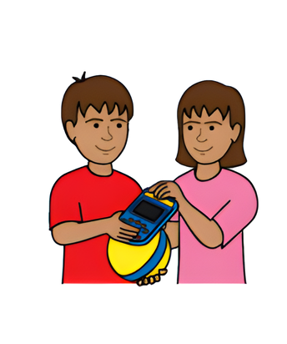
I can play with other children, or I can play by myself.
I might need to share some toys, but I can ask an adult for help if I need it.

Slide 6



If I need a break, I can ask an adult for help.

Slide 7
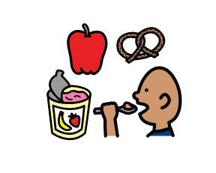
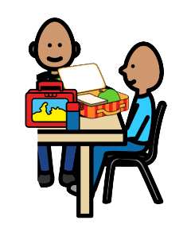

If I am hungry or thirsty, I can have a snack or a drink.
I can eat with the other children if I want.

Slide 8


We might sing some songs and read a story.
I can join in if I want to.

Slide 9



If I like it, I can come back to playgroup again.

