Slide 1



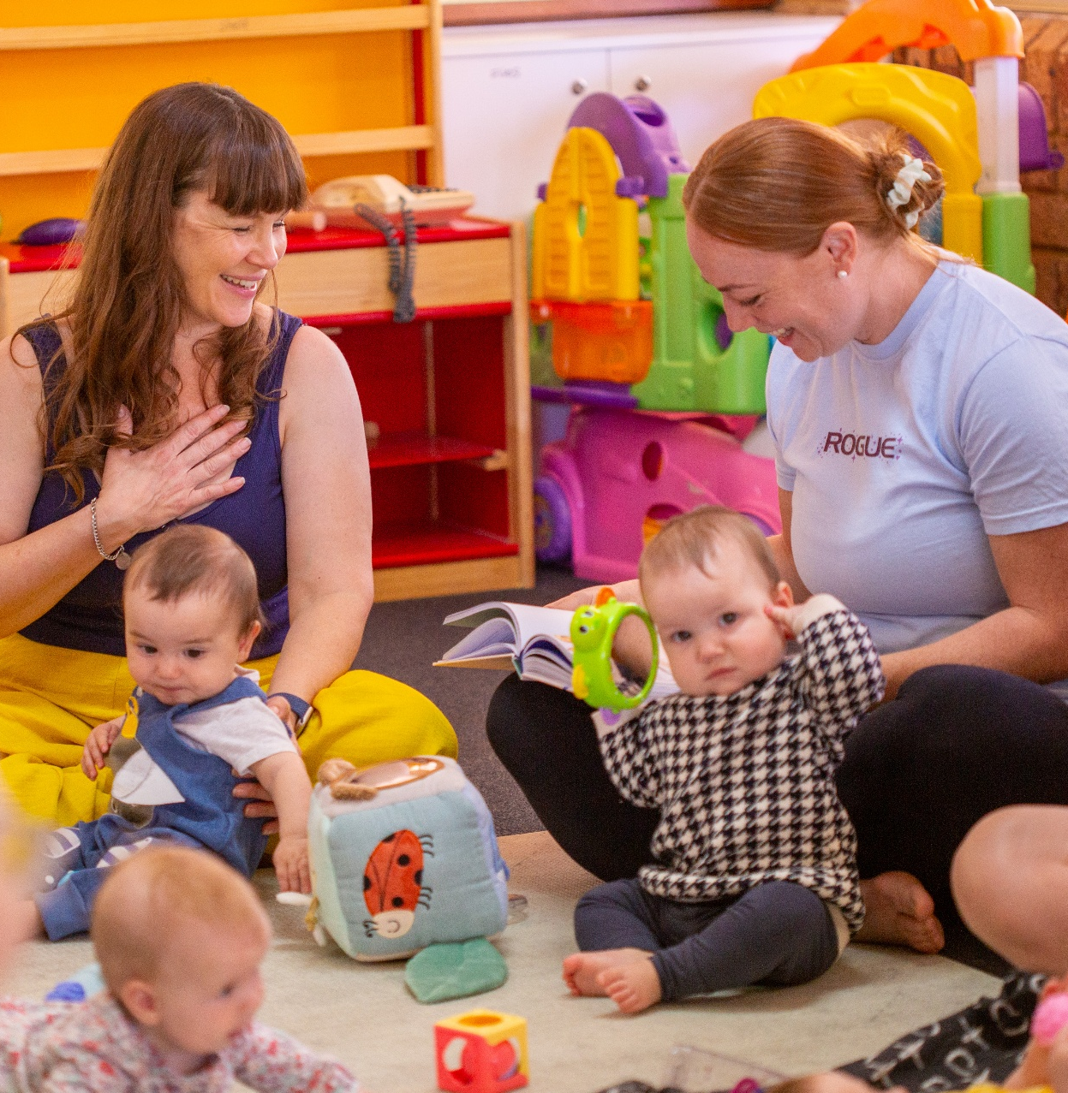




[YOUR LOGO HERE]
INSERT NAME
PLAYGROUP
Come along and join our playgroup! It’s a relaxed space for parents, carers and little ones (aged 0–5) to play, grow and connect
Wednesdays during school term
9:30AM - 11:30AM
123 Anywhere Lane
North Perth, WA
insertnameplaygroup@gmail.com

Slide 2

[YOUR LOGO HERE]
INSERT NAME
PLAYGROUP
Come along and join our playgroup! It’s a relaxed space for parents, carers and little ones (aged 0–5) to play, grow and connect
Mondays | 9:30AM - 11:30AM | All Ages
Wednesdays | 11:30AM - 1:30PM | Babies 0-12 months
Wednesdays
9:30AM - 11:30AM
123 Anywhere Lane
North Perth, WA
insertnameplaygroup@gmail.com
[YOUR LOGO HERE]

Slide 3




[YOUR LOGO HERE]
Insert Name
Playgroup Sessions
Mondays | 9:30AM - 11:30AM | All Ages
Wednesdays | 12:30PM - 2:30PM | All Ages
Fridays | 9:30AM - 11:30AM | Babies 0-12 months
Fridays | 12:30PM - 2:30PM | Spanish Speaking
insertnameplaygroup@gmail.com
0412 345 678
insertnameplaygroup.com.au

Slide 4
[YOUR LOGO HERE]
INSERT NAME
PLAYGROUP SESSIONS
Mondays
9:30AM - 11:30AM
All Ages
Mondays
9:30AM - 11:30AM
All Ages
Wednesdays
12:30PM - 2:30PM
All Ages
Wednesdays
12:30PM - 2:30PM
All Ages
Fridays
12:30PM - 2:30PM
Babies 0-12 months
Fridays
12:30PM - 2:30PM
Babies 0-12 months
insertnameplaygroup@gmail.com
0412 345 678
insertnameplaygroup.com.au

Slide 5

[YOUR LOGO HERE]
[INSERT NAME]
PLAYGROUP
OPEN DAY
Join us for a morning of fun, community & connection
Bring your little ones to explore, play and connect! Discover the magic of our playgroup with morning tea, craft activities and water play. Everyone is welcome!
Please bring a hat and a piece of fruit to share. RSVP by 14 May
Wednesday 21 May
9:30AM - 11:30AM
123 Anywhere Lane
North Perth, WA
insertnameplaygroup@gmail.com

Slide 6



[YOUR LOGO HERE]
WE NEED YOUR HELP!
OUR PLAYGROUP IS LOOKING FOR NEW COMMITTEE MEMBERS!
You don’t need experience, just a little of your time and a willingness to help our playgroup grow and thrive. Playgroup thrives when the load is shared — many hands make light work!
We are currently seeking: [insert role(s) e.g. Secretary, Treasurer, Committee Member]
WHY JOIN?
Help keep our playgroup running
Build your confidence and experience (great for your resume when returning to work!)
Give back to your community
Be part of something special with your child
Interested? Chat to us at your next session or send us a message!

Slide 7


[INSERT NAME]
PLAYGROUP
WHAT TO EXPECT AT OUR PLAYGROUP:
A warm welcoming community
Fun craft and sensory play activities
Storytime and songs
Connections for you and your kids
JOIN NOW:
insertnameplaygroup@gmail.com
[YOUR LOGO HERE]

Slide 8

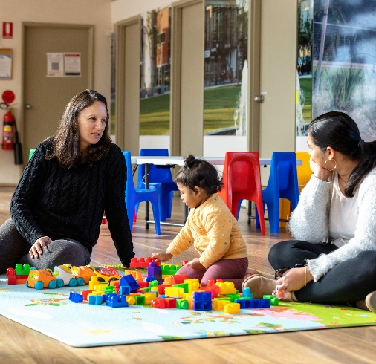
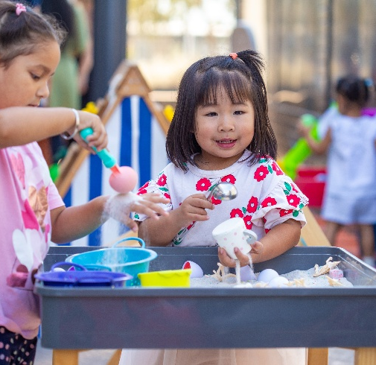
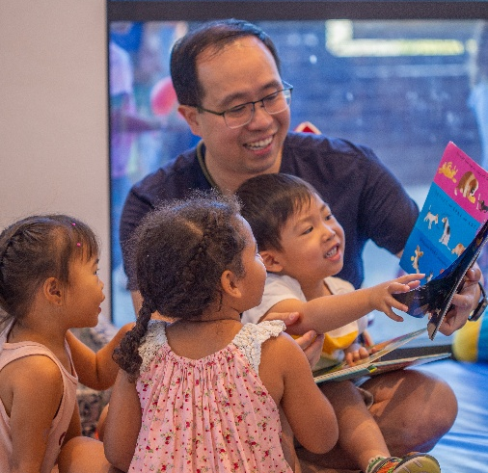
[YOUR LOGO HERE]
What to expect at
[INSERT NAME] PLAYGROUP
A warm welcoming community
Fun craft and sensory play activities
Storytime, songs and rhymes
insertnameplaygroup.com.au
insertnameplaygroup@gmail.com

Slide 9


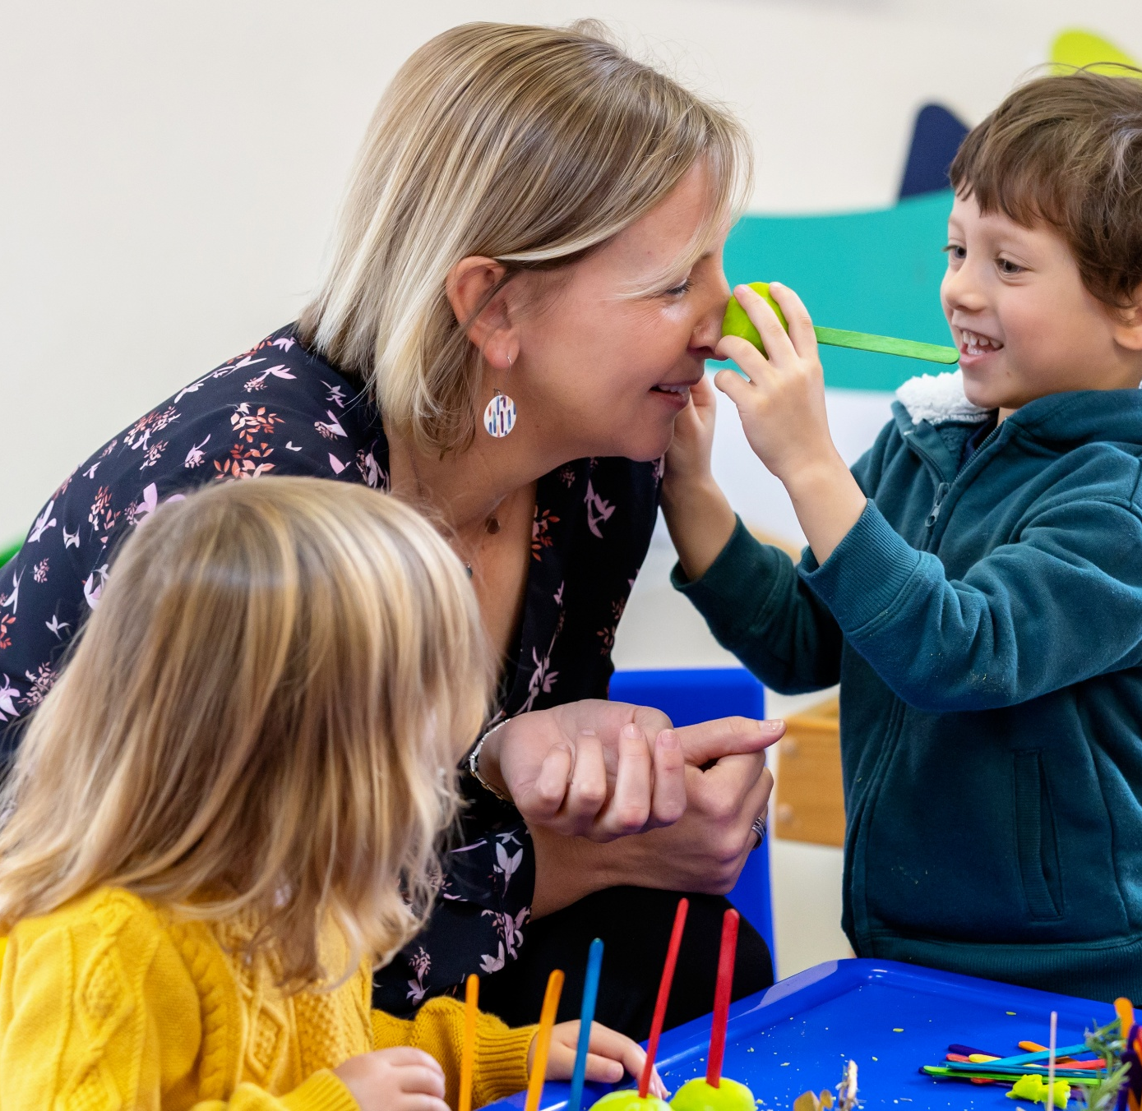



PLAYGROUP STAR
Insert Name
[role at playgroup]
[YOUR LOGO HERE]

Slide 10
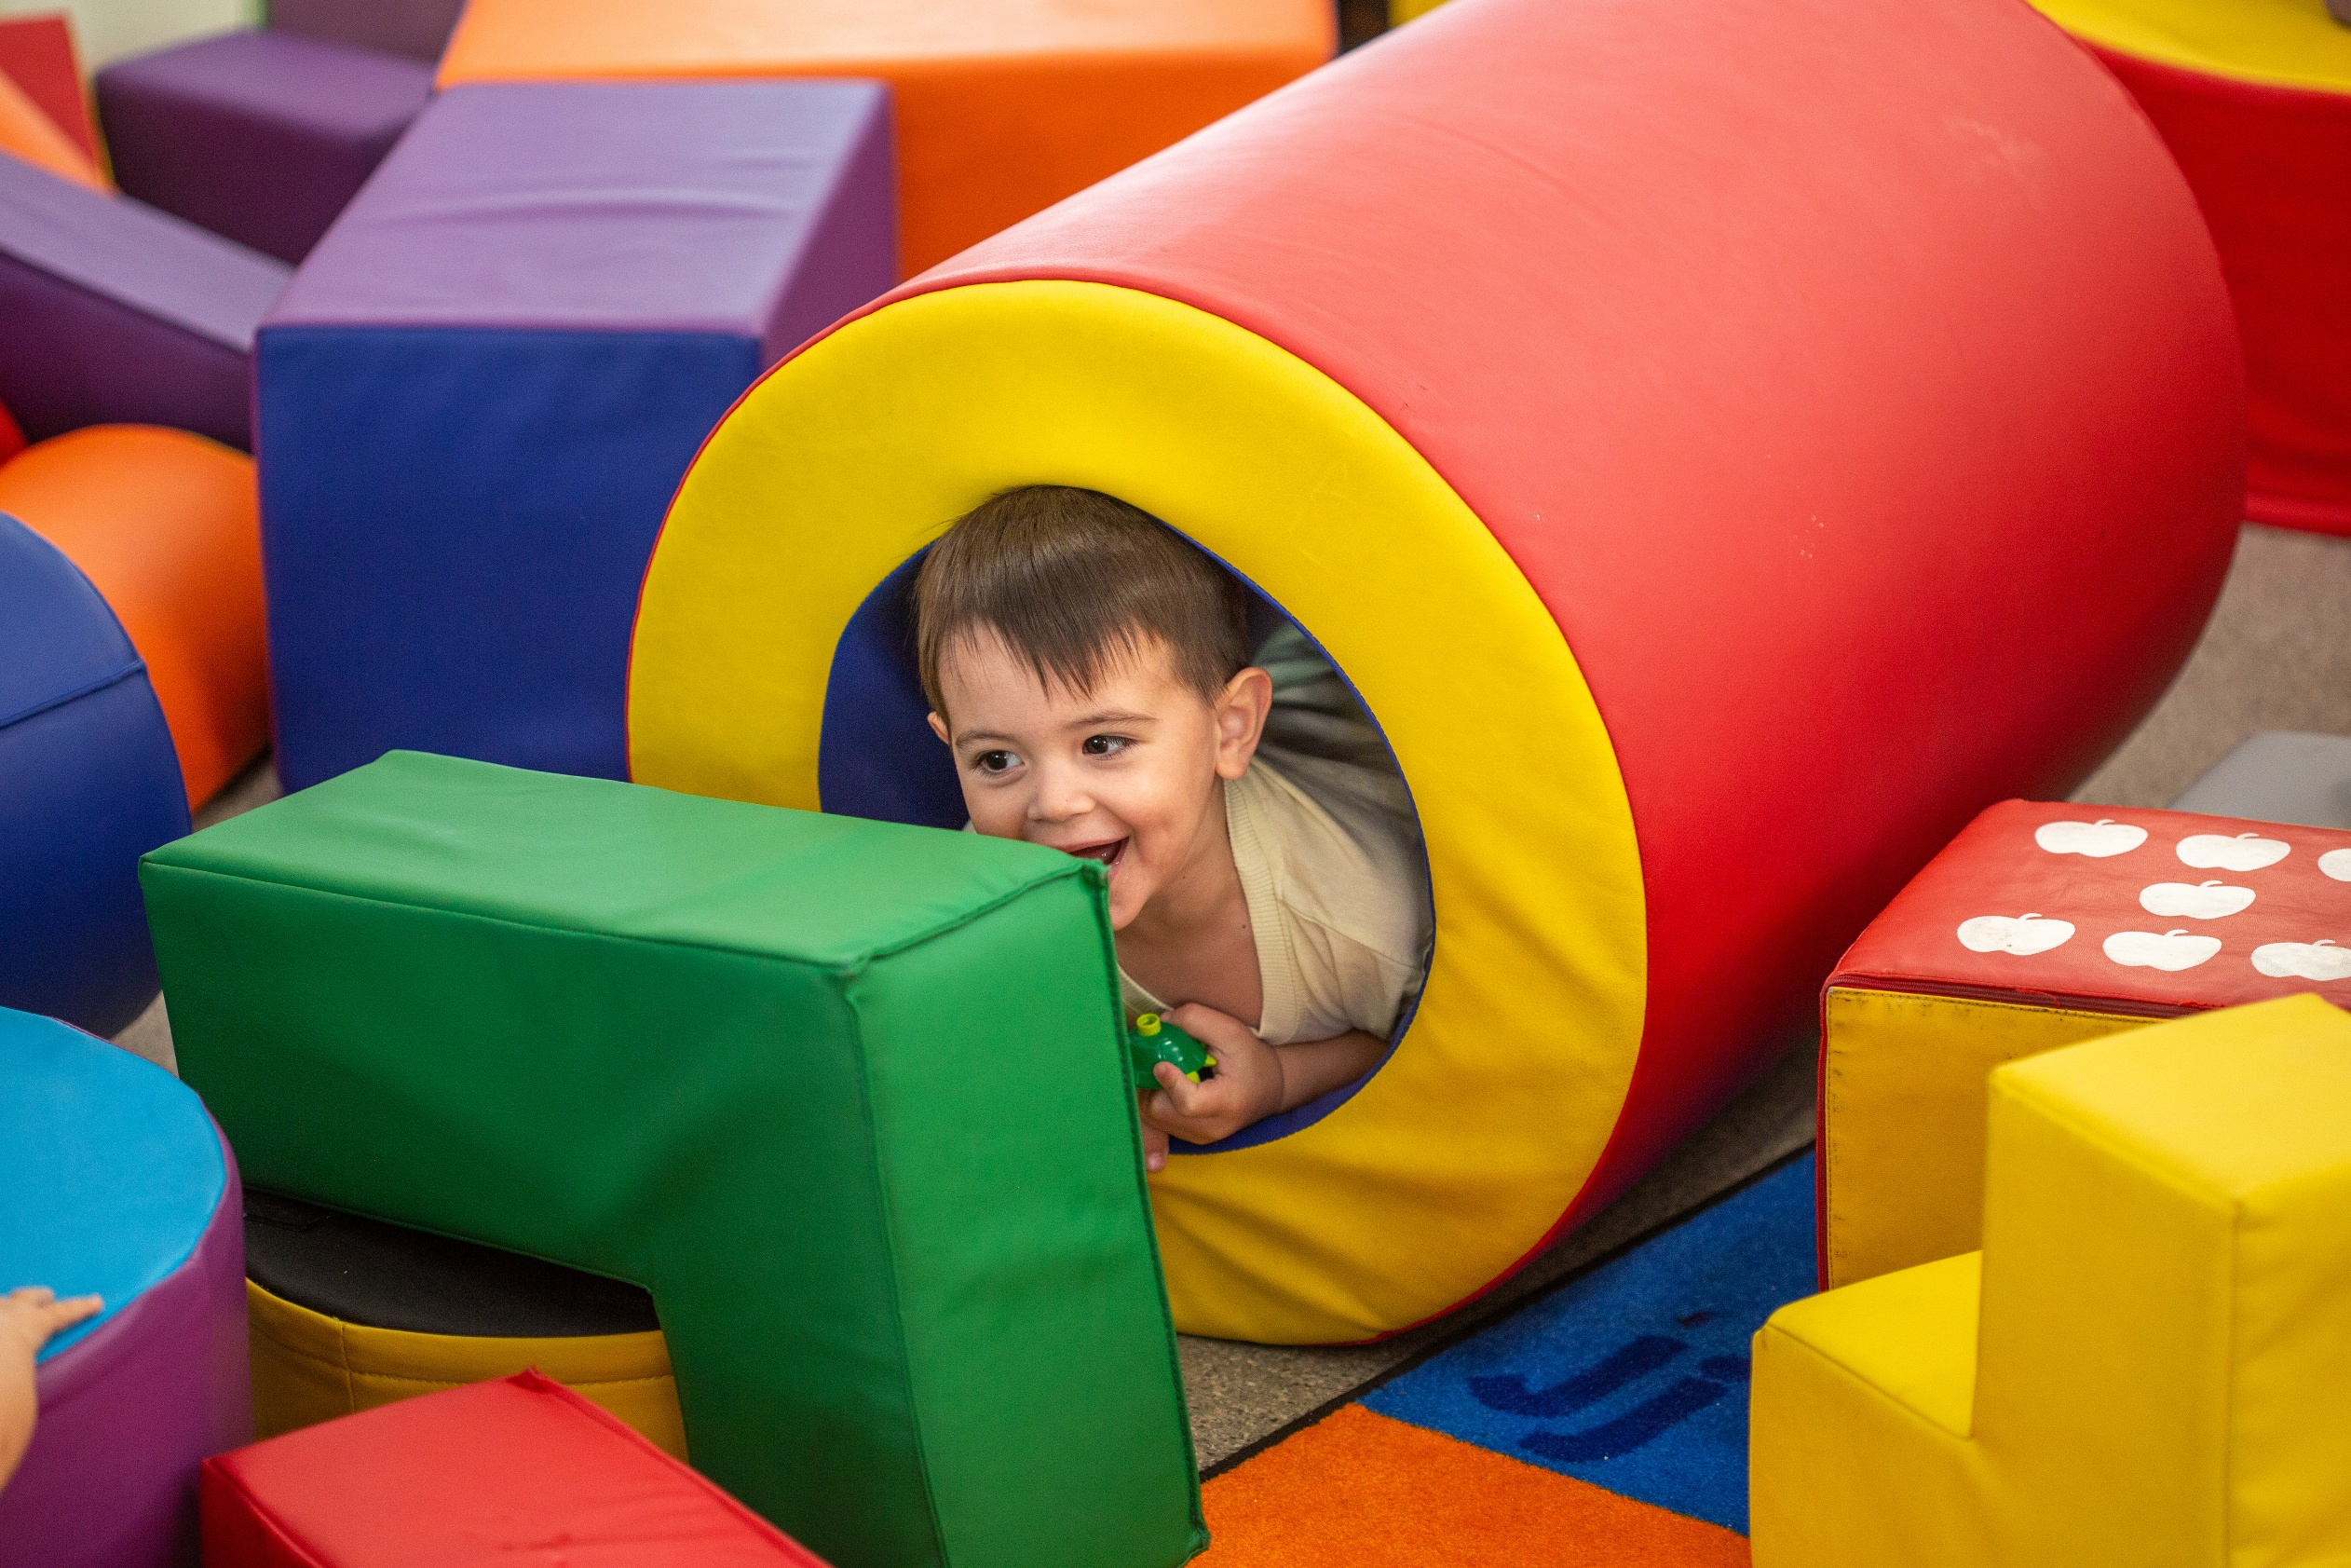



THANK YOU!
Thank you to [insert organisation name] for helping our playgroup thrive! This grant funded [what it was used for], creating a brighter, more playful space for our little ones and their families!
[YOUR LOGO HERE]
[GRANT ORG LOGO]

