Slide 1

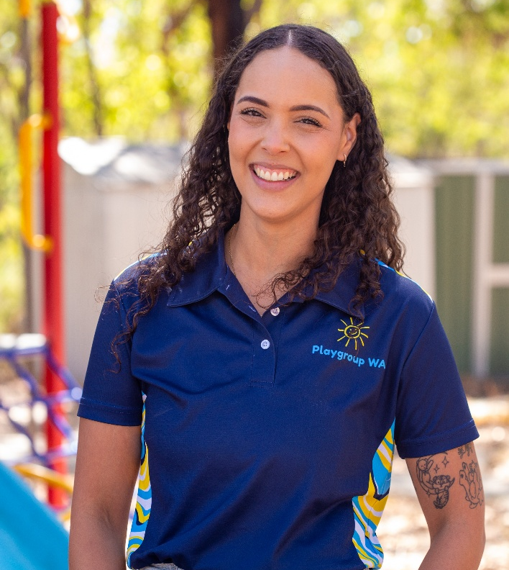
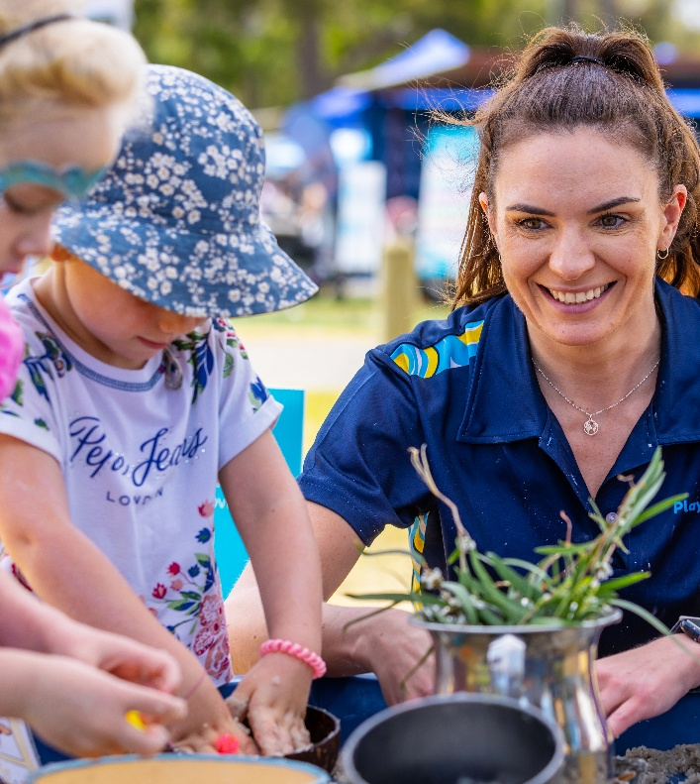

MEET THE TEAM
[First Name]
[Last Name]
Role
[First Name]
[Last Name]
Role
[YOUR LOGO HERE]

Slide 2


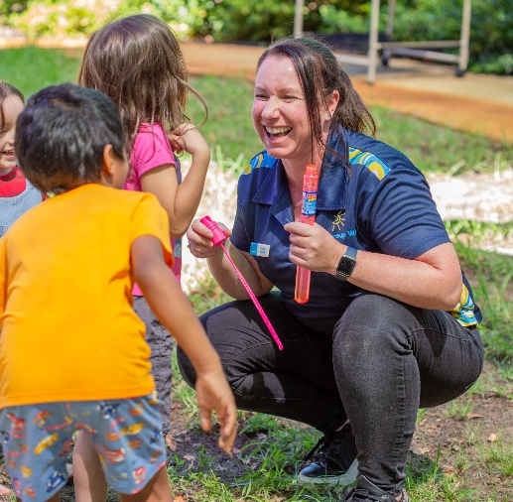
MEET THE TEAM
[First Name] [Last Name]
Role
[First Name] [Last Name]
Role
[First Name] [Last Name]
Role
[YOUR LOGO HERE]

Slide 3



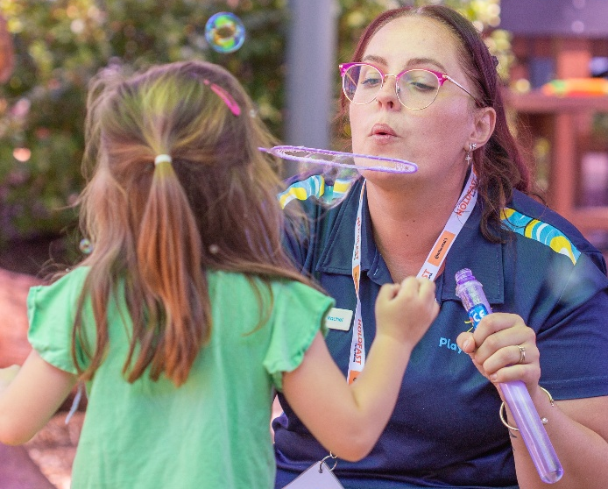
MEET THE TEAM
[First Name]
[Last Name]
Role
[First Name]
[Last Name]
Role
[First Name]
[Last Name]
Role
[First Name]
[Last Name]
Role
[YOUR LOGO HERE]

Slide 4




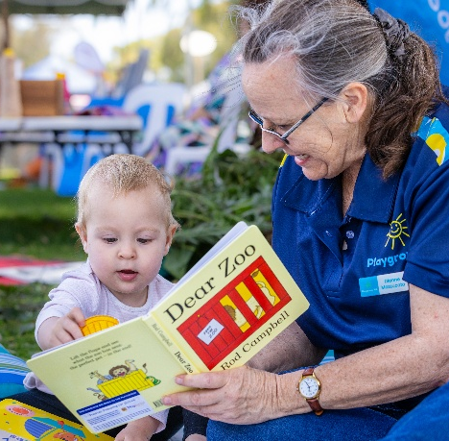
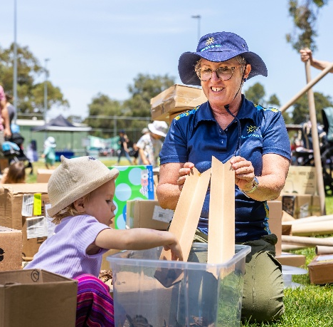
MEET THE TEAM
[First Name]
[Last Name]
Role
[First Name]
[Last Name]
Role
[First Name]
[Last Name]
Role
[First Name]
[Last Name]
Role
[First Name]
[Last Name]
Role
[First Name]
[Last Name]
Role
[YOUR LOGO HERE]

Slide 5




INSERT NAME
PLAYGROUP
Come along and join our playgroup! It’s a relaxed space for parents, carers and little ones (aged 0–5) to play, grow and connect
Wednesdays during school term
9:30AM - 11:30AM
123 Anywhere Lane
North Perth, WA
insertnameplaygroup@gmail.com
[YOUR LOGO HERE]

Slide 6



INSERT NAME
PLAYGROUP
Come along and join our playgroup! It’s a relaxed space for parents, carers and little ones (aged 0–5) to play, grow and connect.
Mondays | 9:30AM - 11:30AM | All Ages
Wednesdays | 11:30AM - 1:30PM | Babies 0-12 months
insertnameplaygroup@gmail.com
0412 345 678
insertnameplaygroup.com.au
[YOUR LOGO HERE]

Slide 7

[YOUR LOGO HERE]
INSERT NAME
PLAYGROUP SESSIONS
Mondays
9:30AM - 11:30AM
All Ages
Mondays
9:30AM - 11:30AM
All Ages
Wednesdays
12:30PM - 2:30PM
All Ages
Wednesdays
12:30PM - 2:30PM
All Ages
Fridays
12:30PM - 2:30PM
Babies 0-12 months
Fridays
12:30PM - 2:30PM
Babies 0-12 months
insertnameplaygroup@gmail.com
0412 345 678
insertnameplaygroup.com.au

Slide 8



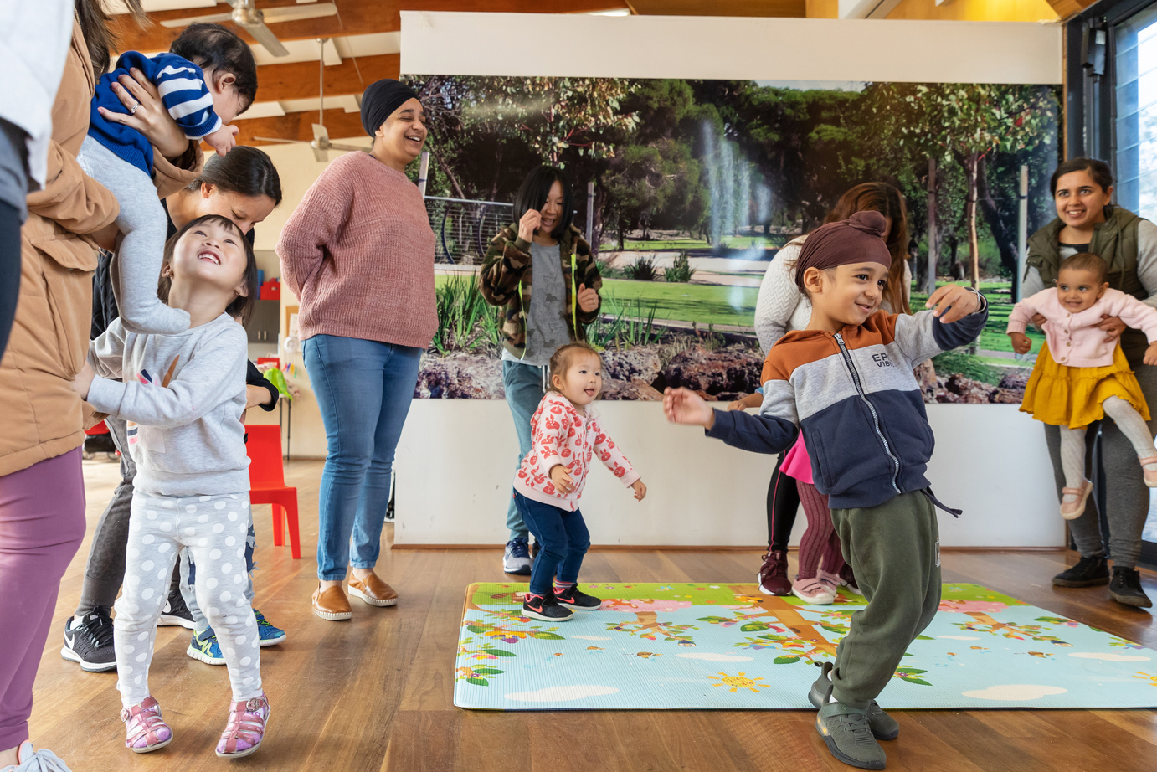
[YOUR LOGO HERE]
INSERT NAME
PLAYGROUP
NEW FAMILIES WELCOME
Are you looking for a friendly place to connect, play and have fun with your little one? Come and join [Insert Name] Playgroup – where families connect, children learn through play, and lasting friendships are made!
CONTACT US TO LEARN MORE!
insertnameplaygroup@gmail.com

Slide 9

[YOUR LOGO HERE]
[INSERT NAME]
PLAYGROUP
OPEN DAY
Join us for a morning of fun, community & connection
Bring your little ones to explore, play and connect! Discover the magic of our playgroup with morning tea, craft activities and water play. Everyone is welcome!
Please bring a hat and a piece of fruit to share.
RSVP by 14 May
Monday
21 May 2026
9:30AM -
11:30AM
123 Anywhere Lane
North Perth, WA
insertnameplaygroup@gmail.com

Slide 10


[YOUR LOGO HERE]
WE NEED YOUR HELP!
OUR PLAYGROUP IS LOOKING FOR NEW COMMITTEE MEMBERS!
You don’t need experience, just a little of your time and a willingness to help our playgroup grow and thrive. Playgroup thrives when the load is shared — many hands make light work!
We are currently seeking: [insert role(s) e.g. Secretary, Treasurer, Committee Member]
WHY JOIN?
Help keep our playgroup running
Build your confidence and experience (great for your resume when returning to work!)
Give back to your community
Be part of something special with your child
📣 Interested? Chat to us at your next session or send us a message!

Slide 11

[INSERT NAME]
PLAYGROUP
WHAT TO EXPECT AT OUR PLAYGROUP:
A warm welcoming community
Fun craft and sensory play activities
Storytime and songs
Connections for you and your kids
JOIN NOW:
insertnameplaygroup@gmail.com
[YOUR LOGO HERE]

Slide 12

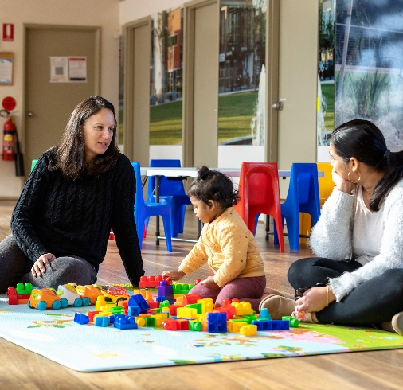
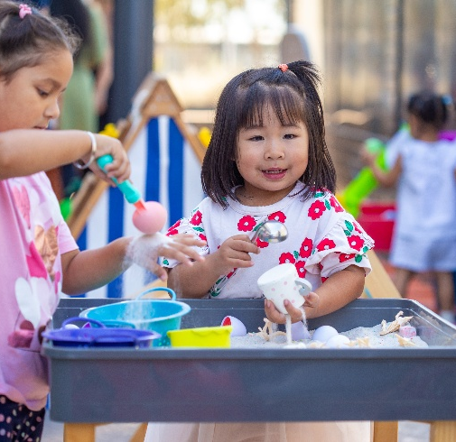
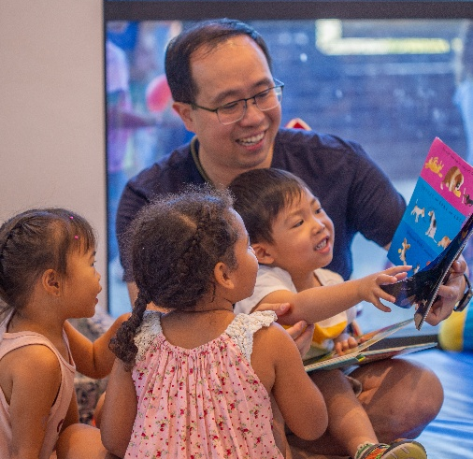
What to expect at
[INSERT NAME]
PLAYGROUP
A warm welcoming community
Fun craft and sensory play activities
Storytime, songs and rhymes
insertnameplaygroup@gmail.com
[YOUR LOGO HERE]

