Slide 1

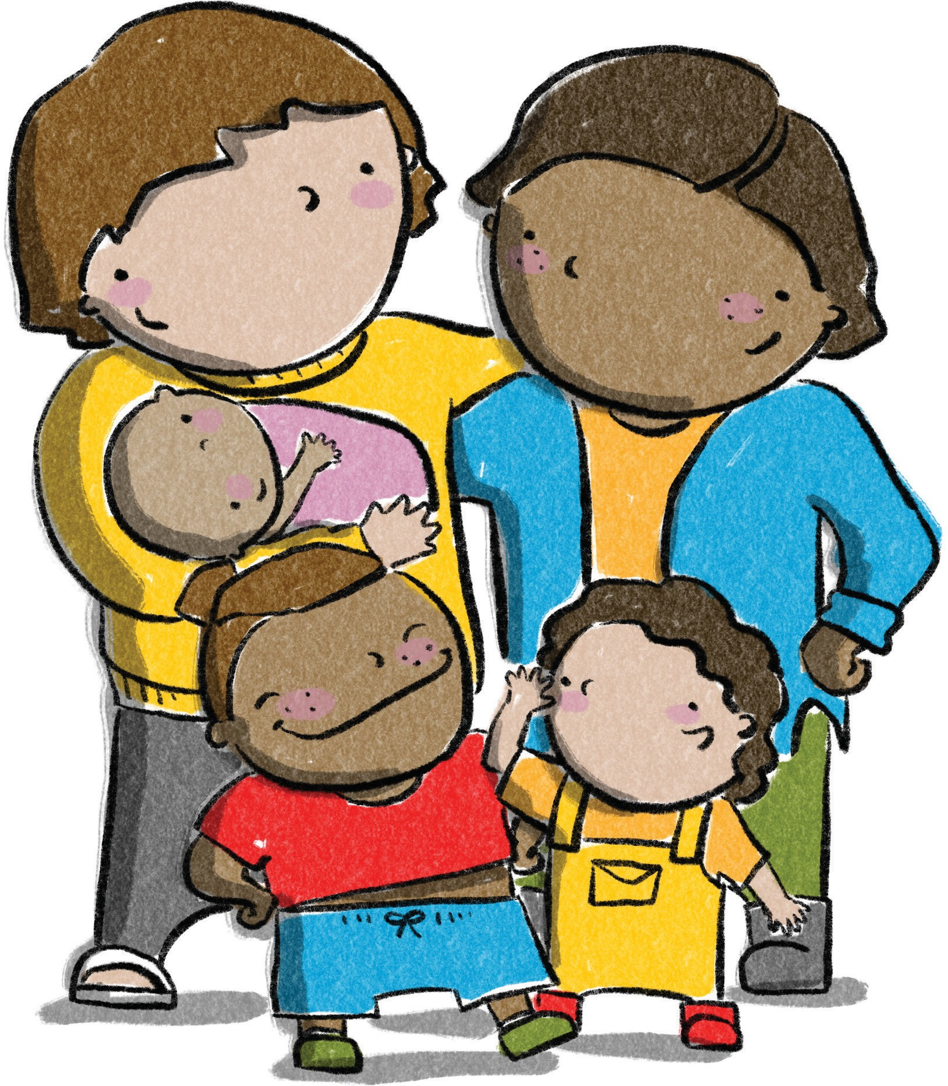
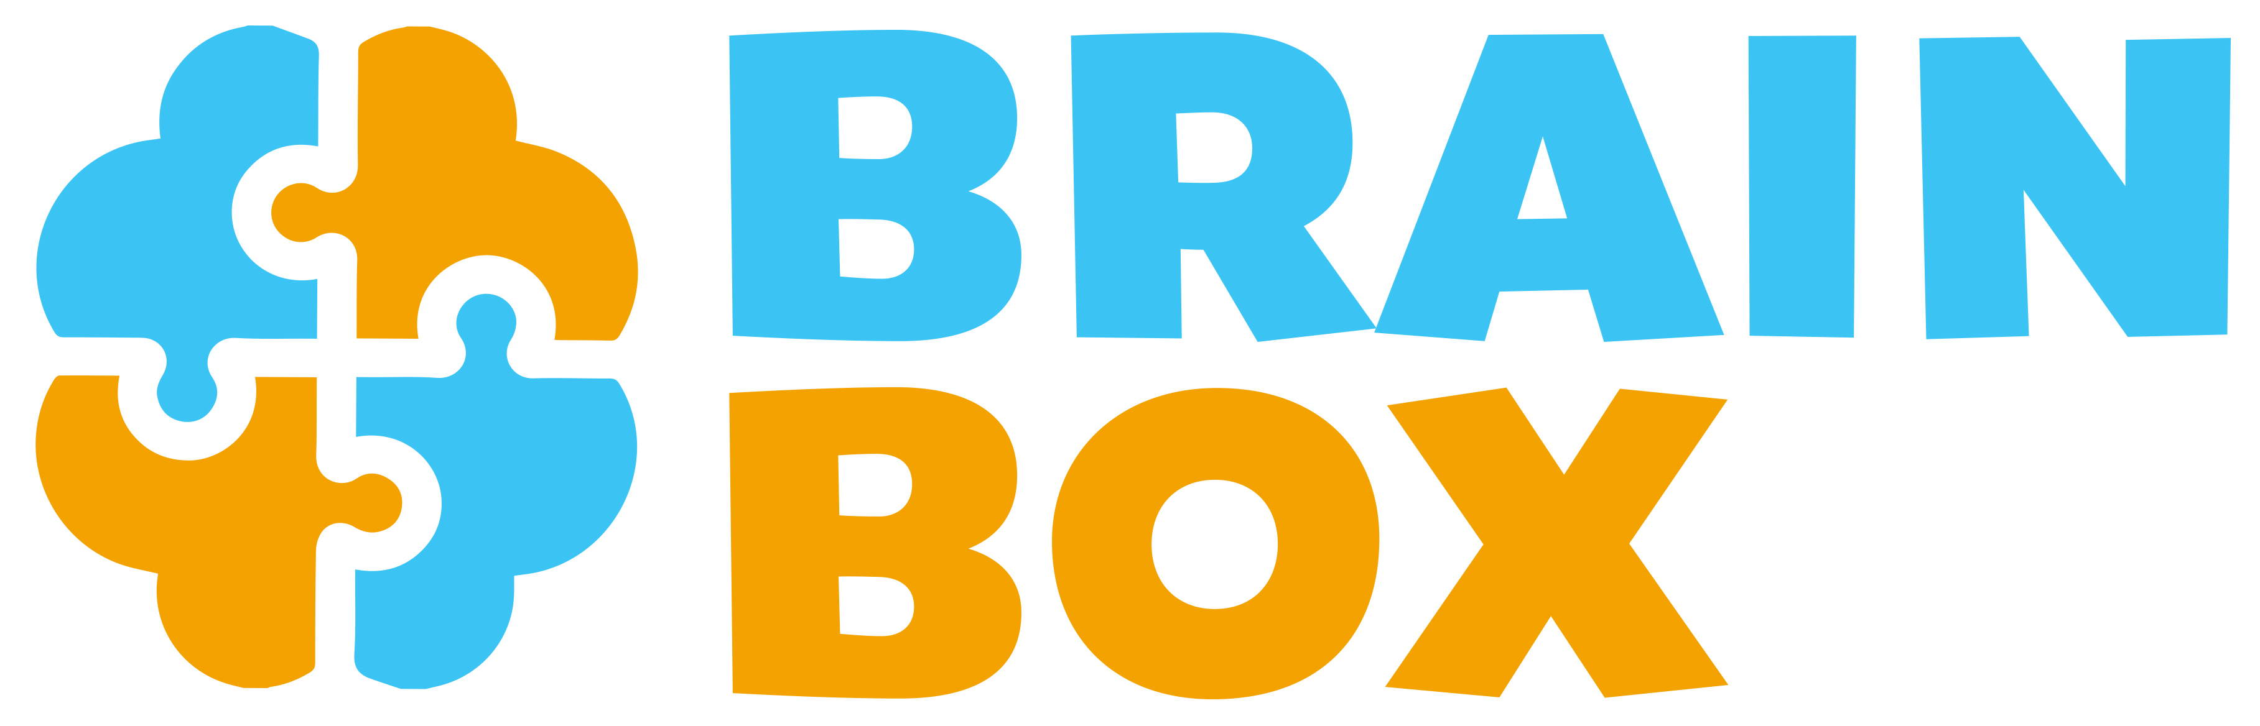








Message One
Brain Box Overview
Notes:
Facilitator Content
Overview of the session
Let your participants know what the session is about. This will depend on the audience and the reason you are meeting.
Facilitator introduction
Introduce yourself. You may like to mention who you are, where you are from and why you are a Brain Box facilitator.
Remember
Acknowledgement of Country and any housekeeping information.

Slide 2
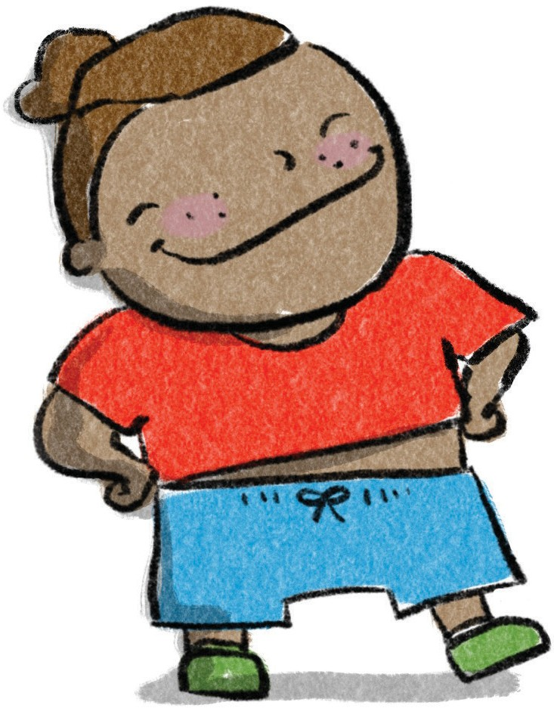

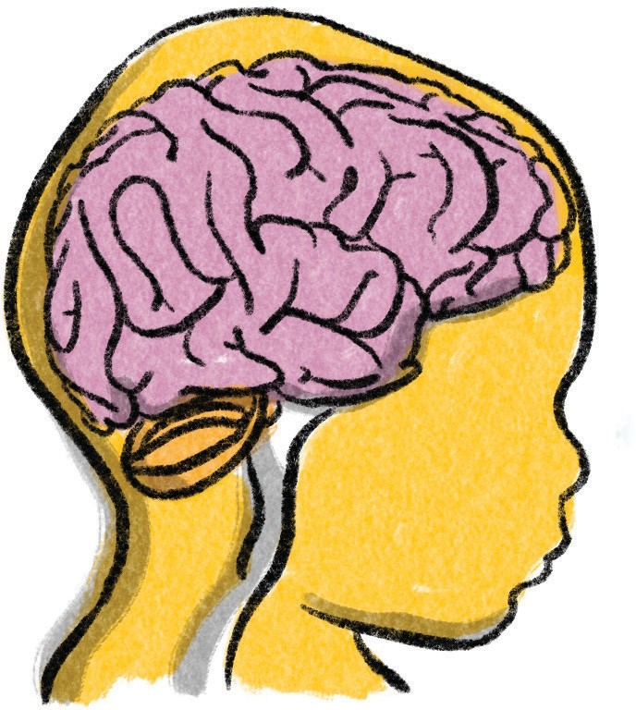
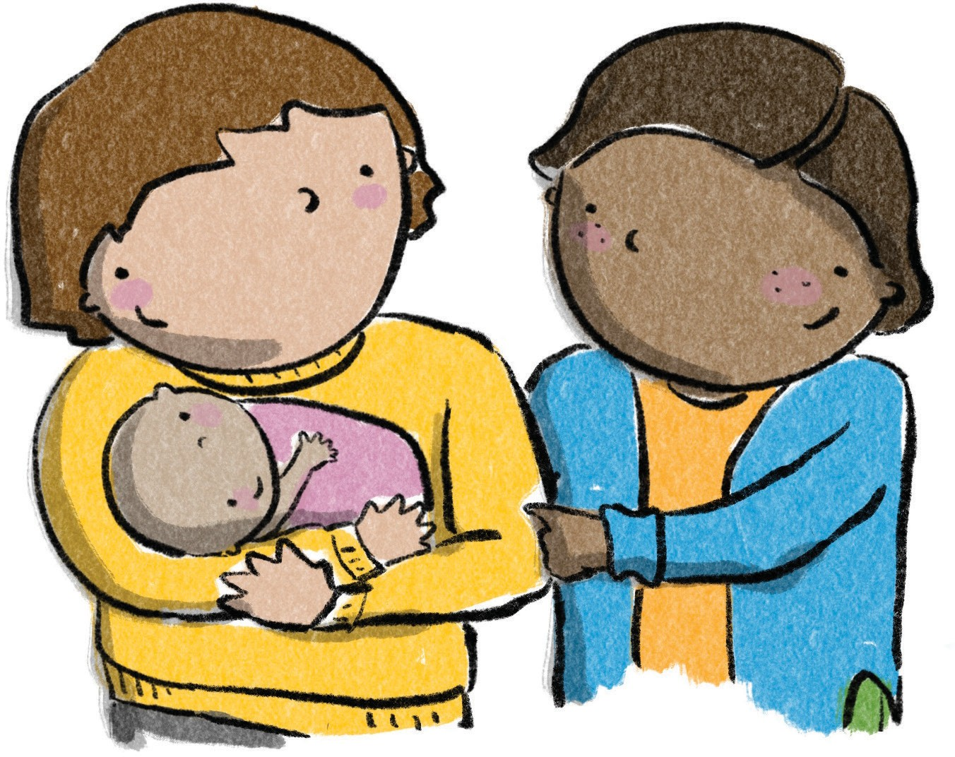


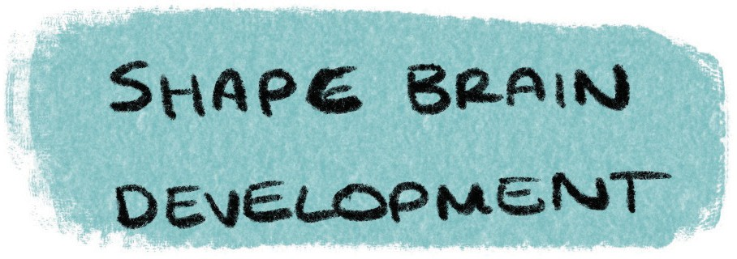


Message Two
Strong Foundations
While genetics provides the initial map or blueprint for brain development,
it is everyday experiences and relationships
that shape a child’s brain.
Notes:
Facilitator Content
Genetics gives the first map for brain development, but it’s everyday experiences and relationships that shape a child’s brain.
For children to reach their full potential, they need a healthy and safe early environment with lots of chances to grow, learn and develop. The early years are super important for shaping who we become.
We know that babies and children do best when their parents have support, starting even before they’re born!
When babies and young children are taken good care of, and they have strong, loving relationships with their parents and caregivers, they grow, learn, and deal better with stress.
Activity – Nature v Nurture
(see Facilitator’s Guide)

Slide 3
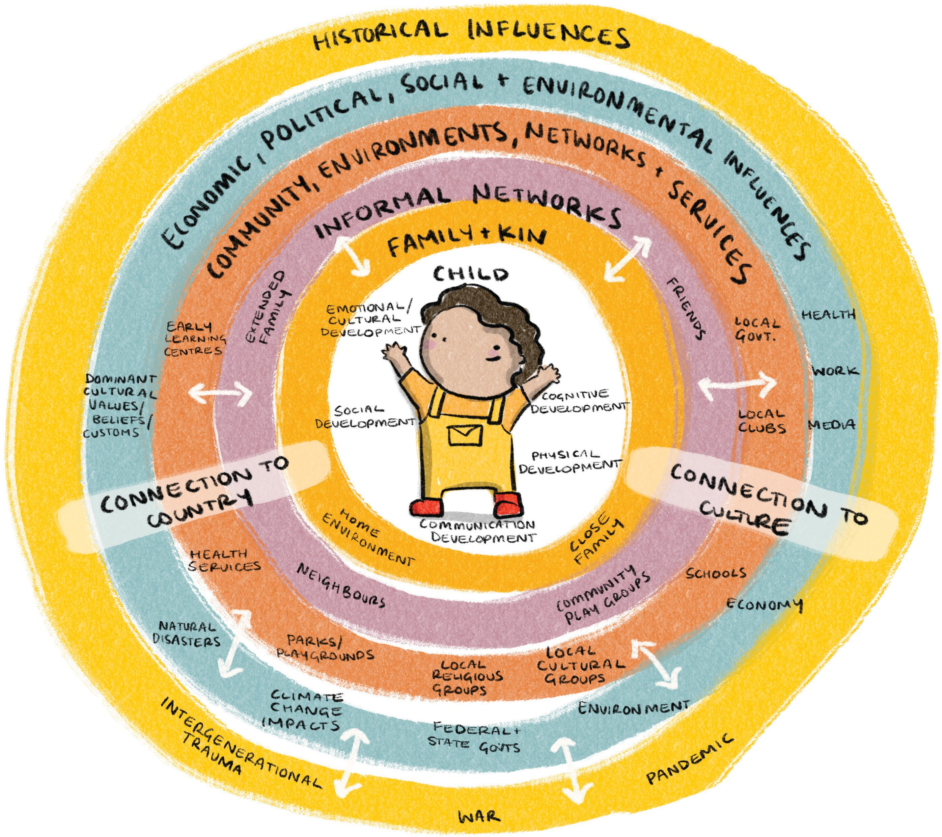
Child Development -
Message Three
it takes a village to raise a child
Based on the Ecological Model of Child Development (Bronfenbrenner 1979)
Notes:
Facilitator Content
Child development is how children grow and become competent physically, socially, emotionally and intellectually. It includes learning to communicate and think, to become the physical child, social child, emotional child, cultural child, talking child and cognitive child (or the thinking/reading/writing child). All these areas of development are interrelated and impact each other.
Many factors influence early brain and childhood development. It’s not just nature or nurture that influences child development, but a combination of both.
Optimal early brain and childhood development depend on positive early relationships, environments and experiences. Family, community and service delivery environments all interact to support optimal development.
Broader systemic influences, such as economic conditions, housing policy, industrial relations, and broad social norms and attitudes, all affect the built and natural environment, community environments, and relationships.
We call it the Ecological Model of Child Development – You may know it as ‘It takes a village to raise a child!’
Healthy communities build healthy brains and optimal child development. Supporting parents and families, and providing safe harbours when families face life’s challenges, builds healthy brains and helps children thrive. It really does take a village to raise a child!
Supporting the development and learning of babies, toddlers, and young children paves the way for good physical and mental health, learning and wellbeing throughout life. Supporting early childhood development leads to good health and wellbeing in the present and the future.

Slide 4
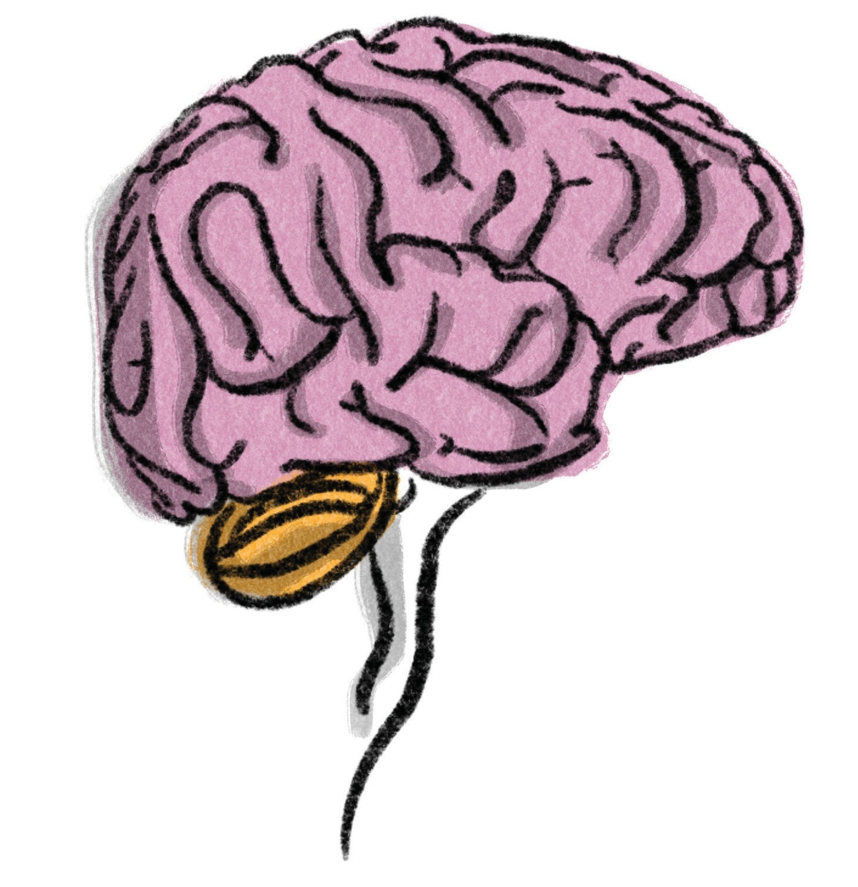
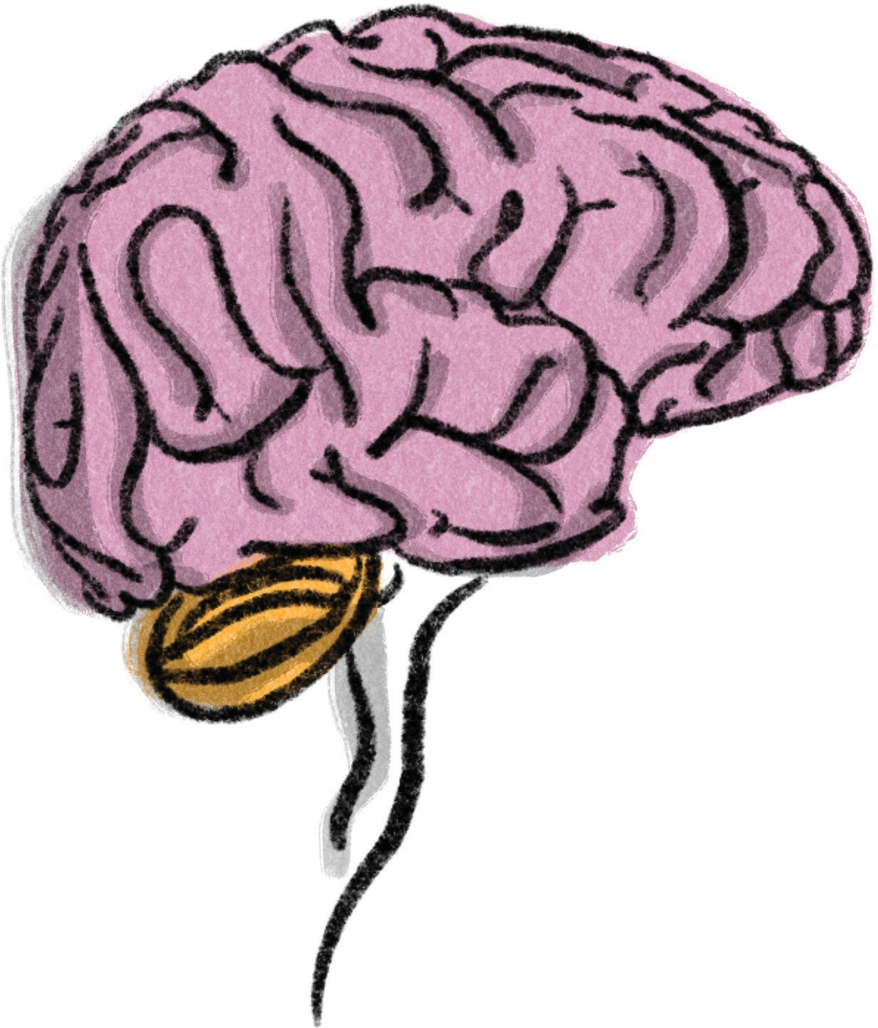

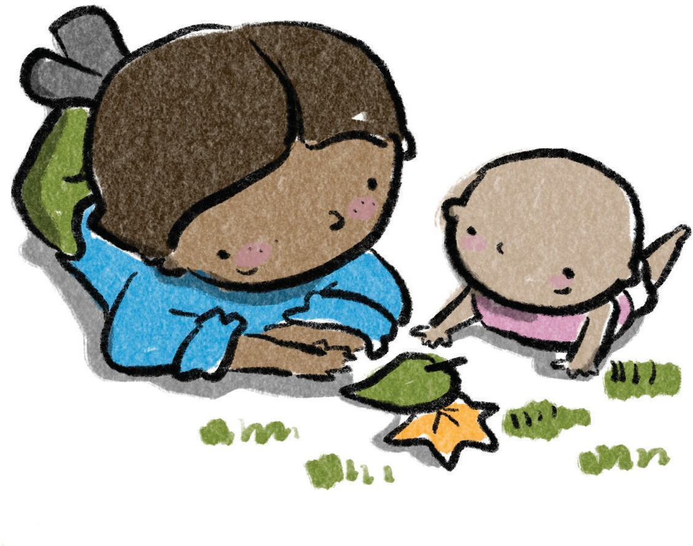
Message Four
Brain Growth
Brains are built over time based on relationships and experiences.
Notes:
Facilitator Content
Our brains grow and change based on what we experience and how we interact with others. It all starts when we’re just tiny fetuses and continues until we’re in our mid to late 20s. When we’re born, our brains only weigh about 400g and have around 100 million neurons that mostly aren’t connected to each other yet. Neurons are like special brain cells that send and receive information through electrical and chemical signals.
By the time we are three years old, our brains have grown to about 1100g and have formed about 1000 trillion connections between neurons called synapses. These connections make up the basic framework of our brain. It’s amazing how much our brains grow during those first few years of life. We gain 700g in just three years! After that, we only gain another 200g as we grow into adulthood. The average adult brain weighs about 1300g and has around 500 trillion neuron connections.
The early years of brain development are super important because they lay the foundation for everything that comes after - learning, health and wellbeing. And even after those early years, our brains keep changing and adapting throughout our whole lives.
Activity – Brains
(see Facilitator’s Guide)

Slide 5

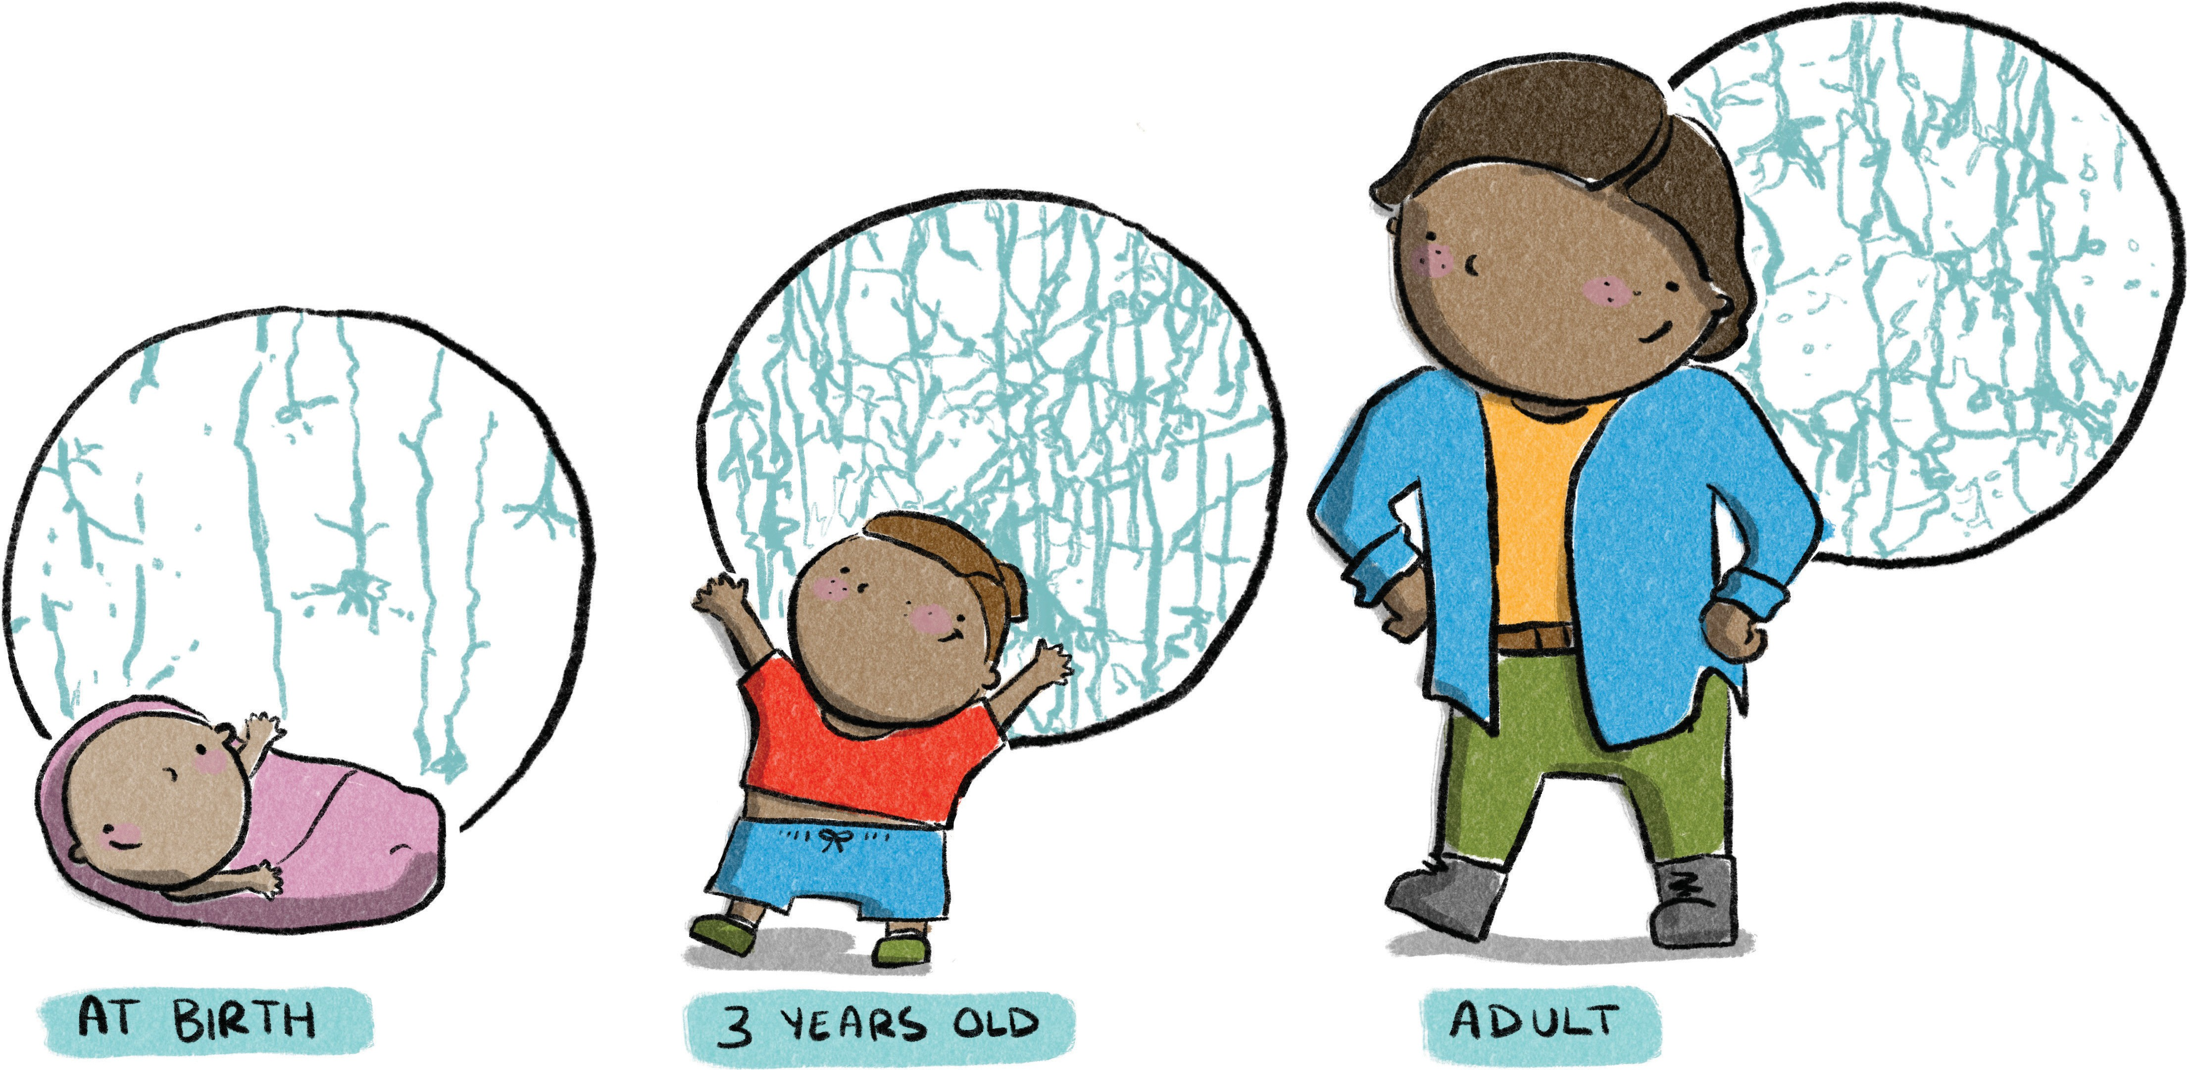
Message Five
Brain development begins shortly after conception and continues into our mid to late-20s.
Brain Building
A newborn baby has most of the neurons they’ll have for the rest
of their life. What really makes the brain work are the connections between those brain cells and the early
years are a crucial
time for making those connections.
Notes:
Facilitator Content
When a baby is born, they have most of the neurons that they will have for the rest of their life. But it is the connections between these neurons that really make the brain work.
Brain connections are developed through a child’s everyday experiences, such as positive interactions with parents and caregivers, and using their senses to engage with the world. Simple neural connections and skills are formed first, followed by more complex circuits and skills.
The more often an experience is repeated, the stronger the connections become. Connections that are used more often become stronger and more permanent, creating rapid pathways for neural signals to pass through the brain. Early and frequent experiences are essential for building a strong foundation for neural connections.
During adolescence, the brain goes through another phase of change, pruning back weaker and less used connections to become more efficient. By adulthood, a person has about half the neural connections they had at three years of age.
Research has shown that the brain continues to change and develop throughout life, making new brain cells and modifying neural connections to better cope with new circumstances. However, interventions are much slower to make changes and require more effort as children get older and into adulthood.
Early experiences shape how the brain is built, with a strong foundation in the early years increasing the likelihood of positive outcomes, and a weak foundation increasing the chances of later difficulties.
Activity – Neural Connections
(see Facilitator’s Guide)

Slide 6

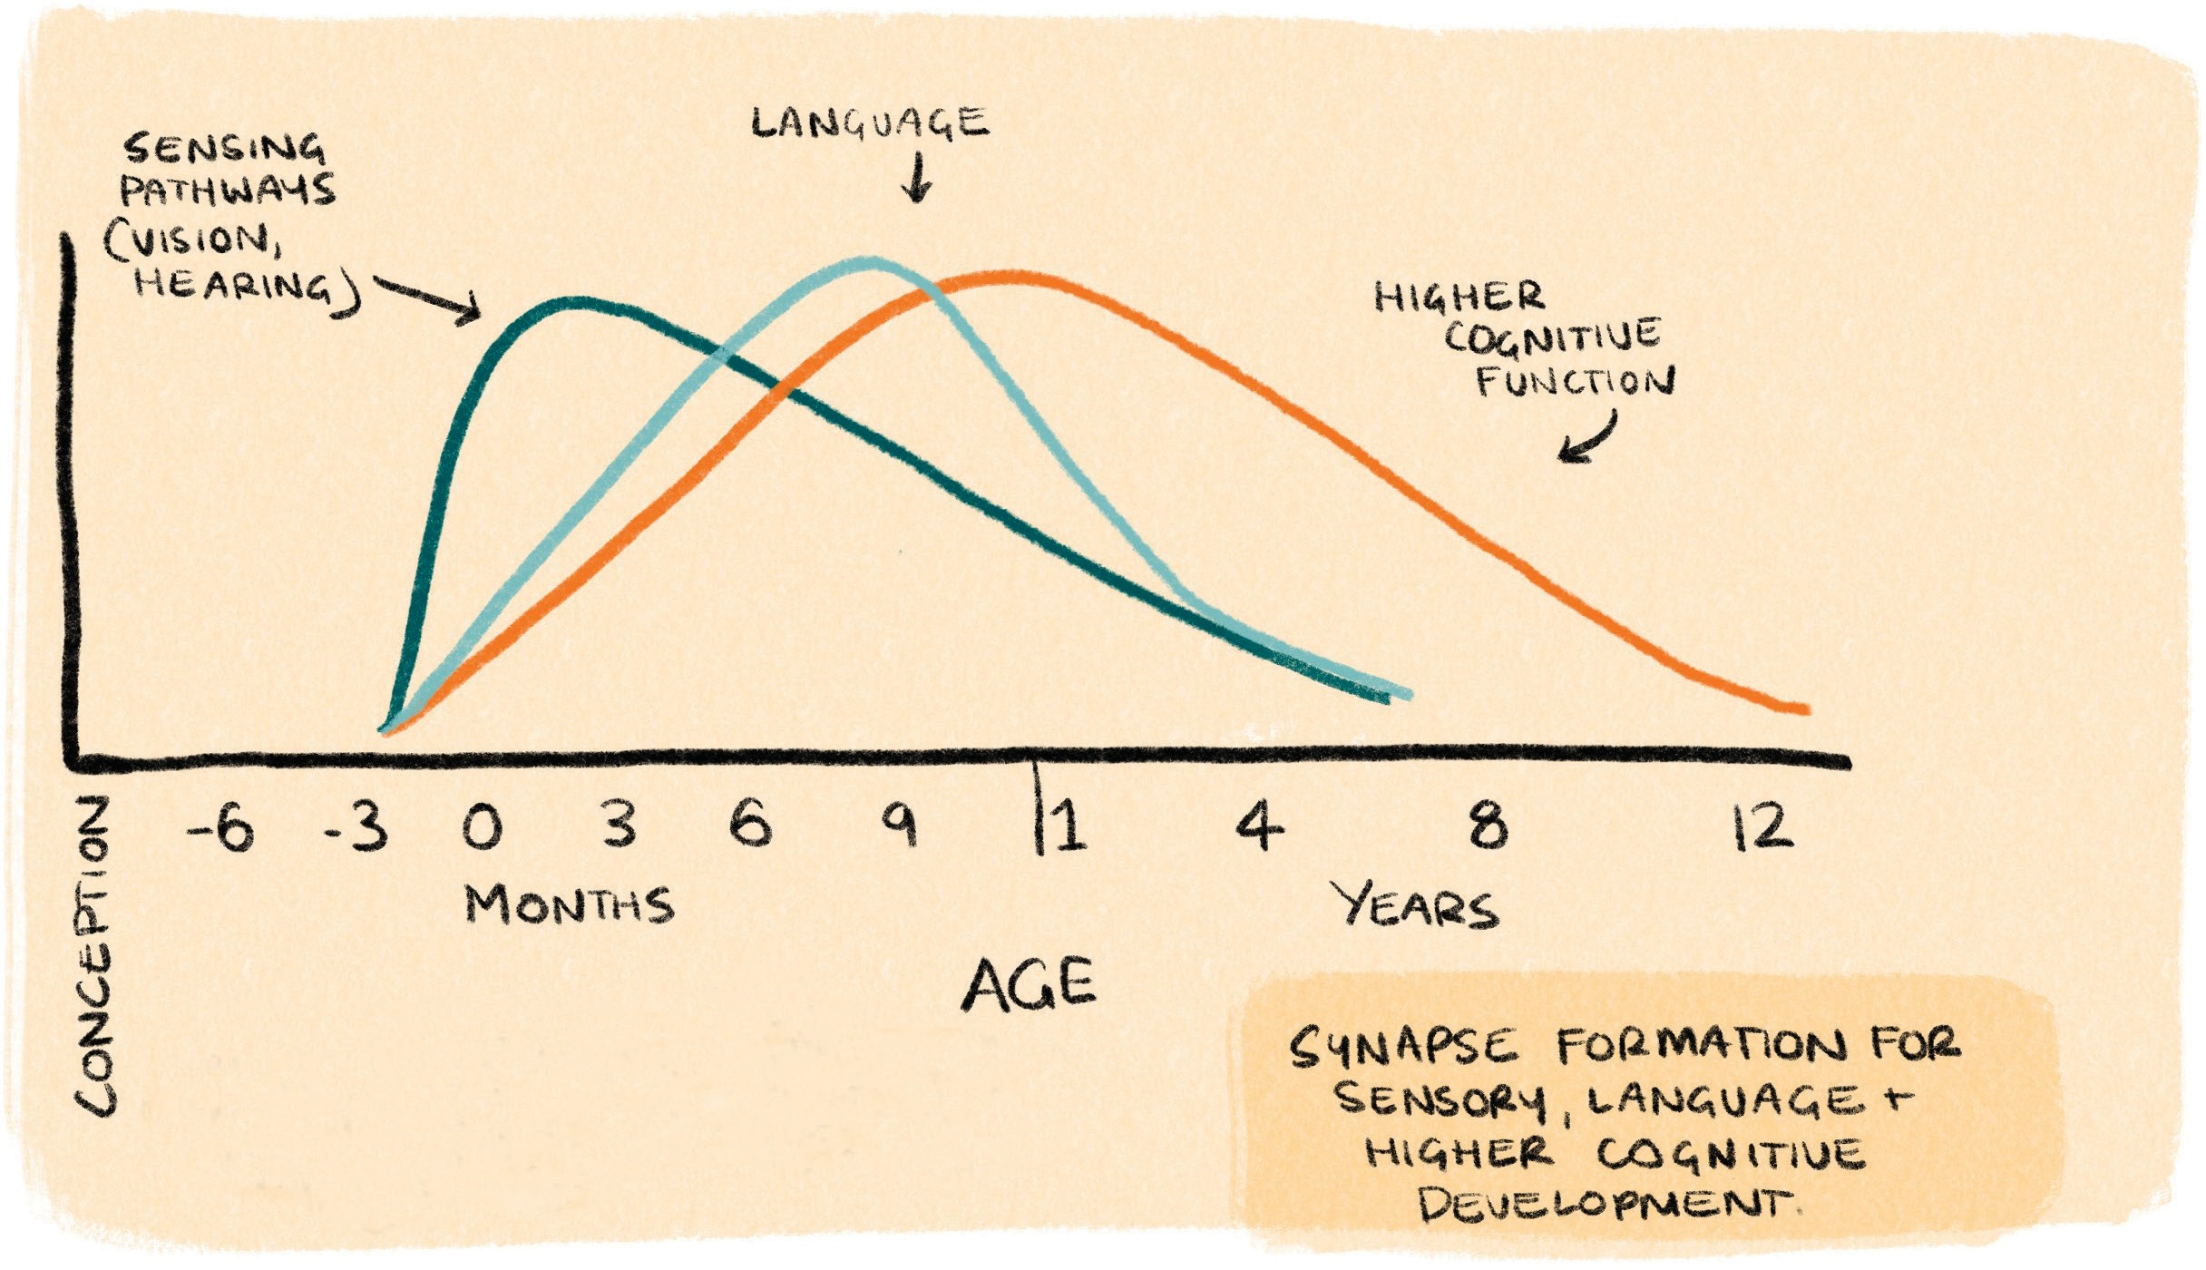

Message Six
Strong Brains
We now know that the major influence on the developing brain is interaction between child and parents, caregivers, family and community.
Brains are built from the simplest circuits to the more complex.
And remember, the different regions of
our brains develop in connection with each other, not in isolation.
Synapse formation for sensory, language and higher cognitive development
By C. Nelson in From Neurons to Neighbourhoods (2000)
Notes:
Facilitator Content
When we are babies, our brains start building from the basics and gradually add more complex skills. It’s important to remember that different parts of our brains work together, not by themselves.
Each part of our brain is responsible for different things, like seeing or hearing.
Different sets of connections grow at different times and in a specific order. The basic sensory pathways, like seeing and hearing, start developing a few months before we’re born and peak at around three months old.
Language pathways, for talking and understanding language, start developing at least from birth and peak at around 9-10 months old. Before we can develop strong language pathways, we need to have our vision and hearing pathways working properly.
Higher-level memory and thinking, reading, writing, and problem-solving, develop pathways and peak between 1-4 years old. This process takes longer and happens gradually.
We now know that the most important thing for a baby’s brain development is how much they interact with their parents, caregivers, family and community.

Slide 7
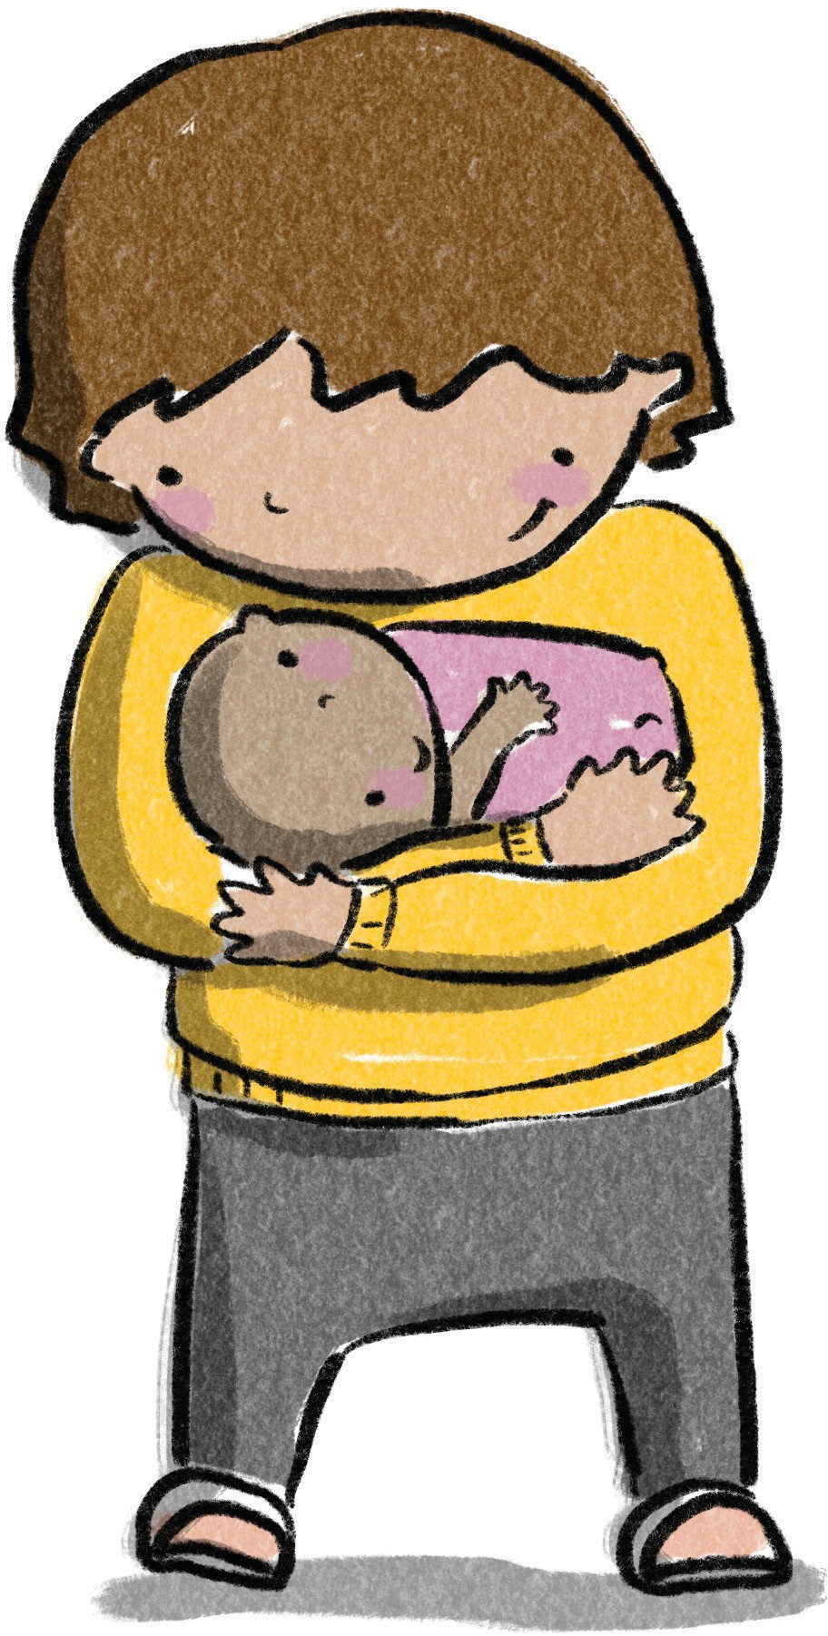

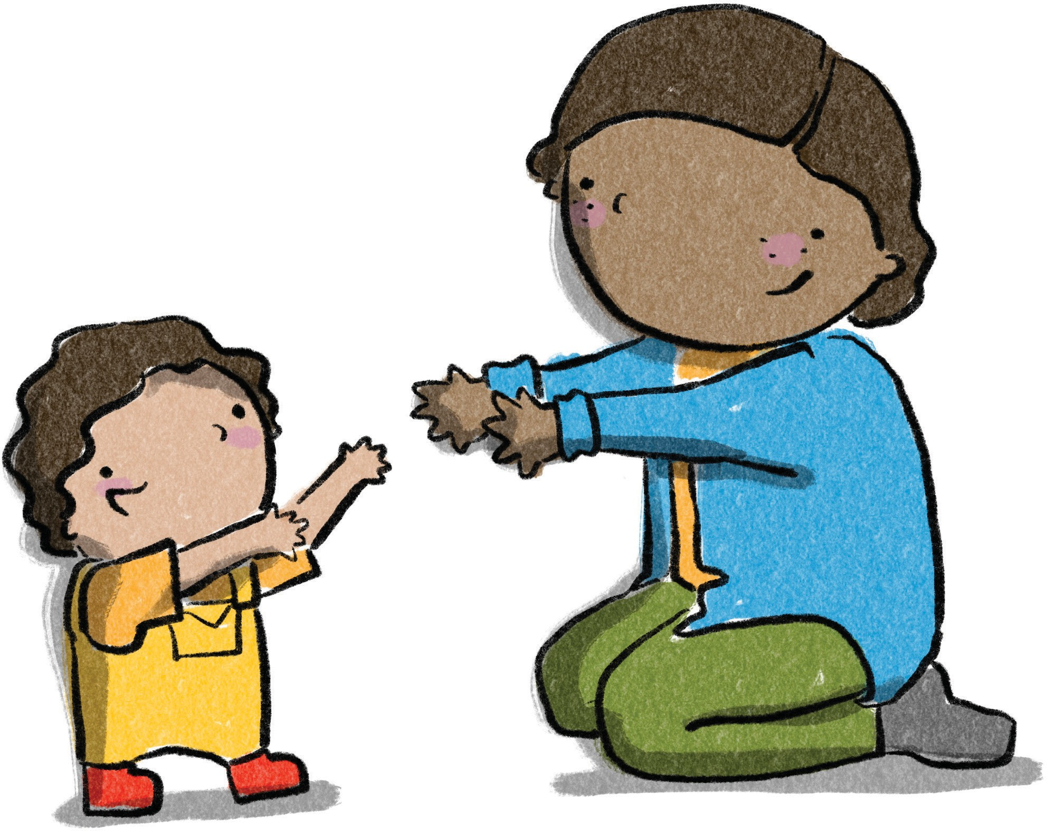
Message Seven
Nurturing Relationships
Children develop in the context of relationships.
Even before
birth, babies begin to form relationships with caregivers.
Notes:
Facilitator Content
Children develop in the context of relationships, which begins in pregnancy and continues from the moment they are born through forming connections with their caregivers.
These relationships are essential for the healthy development and wellbeing of children and their families.
When caregivers focus on building a positive foundation of relationships, children thrive both now and in the future.
Our responses to babies shape their emotional experiences and teach them how to regulate (manage) and express their feelings.
If someone responds kindly and appropriately to a baby when they cry, the baby learns that they matter, that they can rely on their caregiver to help them when they are upset, and how difficult emotions can be worked through.
Children develop within a network of relationships that involve family members and other important adults in their lives, including neighbours, friends, grandparents, extended family members and early childhood professionals.

Slide 8
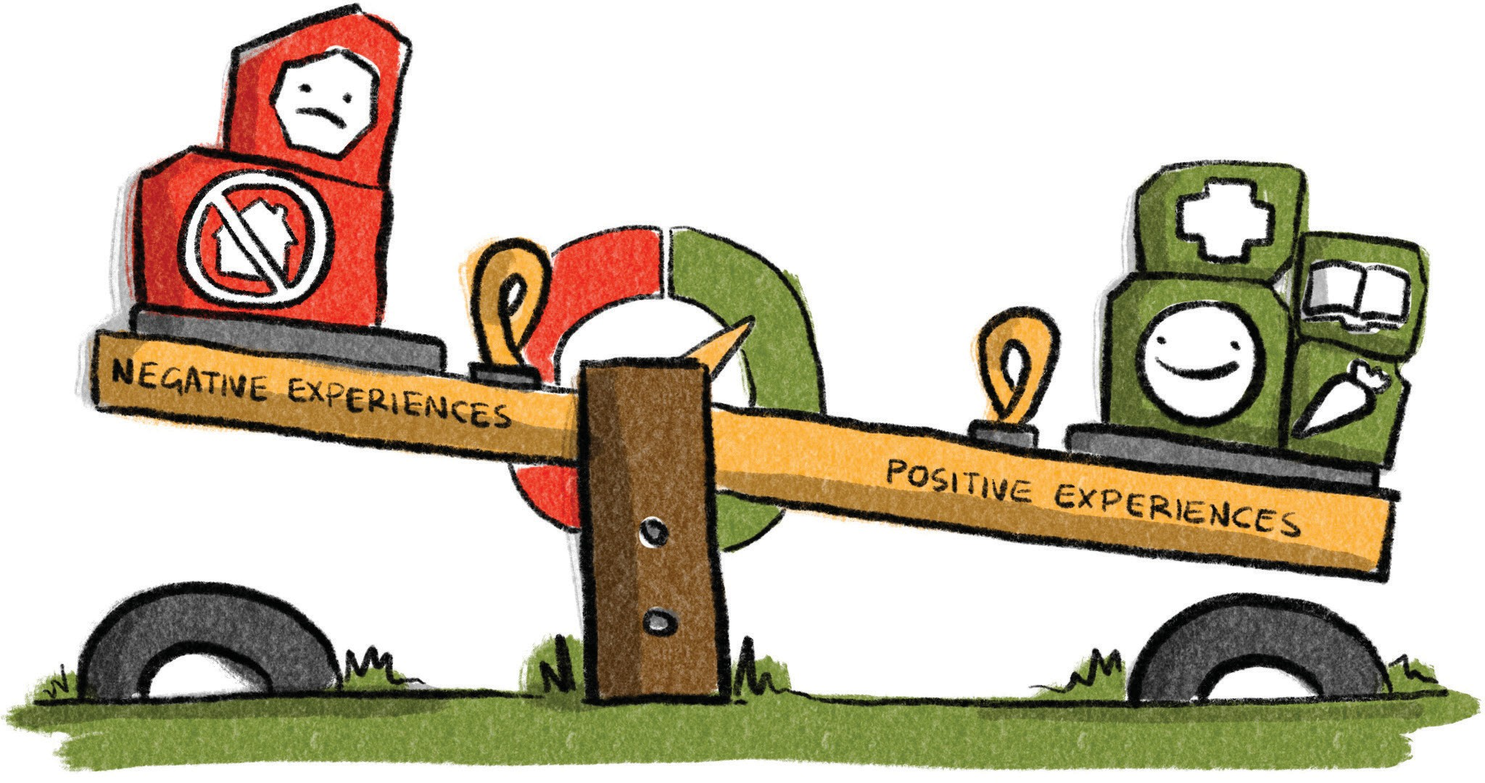
Message Eight
Stress and Protective Factors
Increasing
positive influences
and experiences, accumulating protective factors, can counteract toxic stress and provide a child with the best chance of optimal early brain
and childhood development.
Notes:
Facilitator Content
Stress can either strengthen or weaken the brain depending on the duration and intensity of stress and the presence of caring and responsive adults.
Some stress is okay, like trying new things or meeting new people, as it builds resilience. Other stress, like a natural disaster or losing someone close, is tolerable when buffered by supportive caregivers. But toxic stress is different.
Toxic stress occurs when children experience frequent and long-term negative experiences without the support of caring adults to help them cope. Toxic stress disrupts brain development, resulting in long-term physical and mental health problems.
Toxic stress triggers the body’s fight/flight/freeze response, which can become overactive and slow to shut down, causing intense feelings of anxiety, even when not under threat.
Prolonged exposure to toxic stress can also cause the stress response to become under-reactive, leading to a lack of responsiveness and blunted feelings.
During a stress response, the part of the brain responsible for executive functions, like problem-solving and impulse control, has less opportunity to develop, resulting in poor focus, analysis and prioritisation skills.
However, risk is not destiny, and there are ways to counteract toxic stress. Reducing stressors in children’s and families’ lives, removing roadblocks, building responsive relationships and developing core resilience skills can help mitigate the negative effects of toxic stress.
Increasing positive influences and experiences and accumulating protective factors can counterbalance stressors and provide children with the best chance for optimal brain and childhood development.
Activity – Brain Development Factors
(see Facilitator’s Guide)

Slide 9
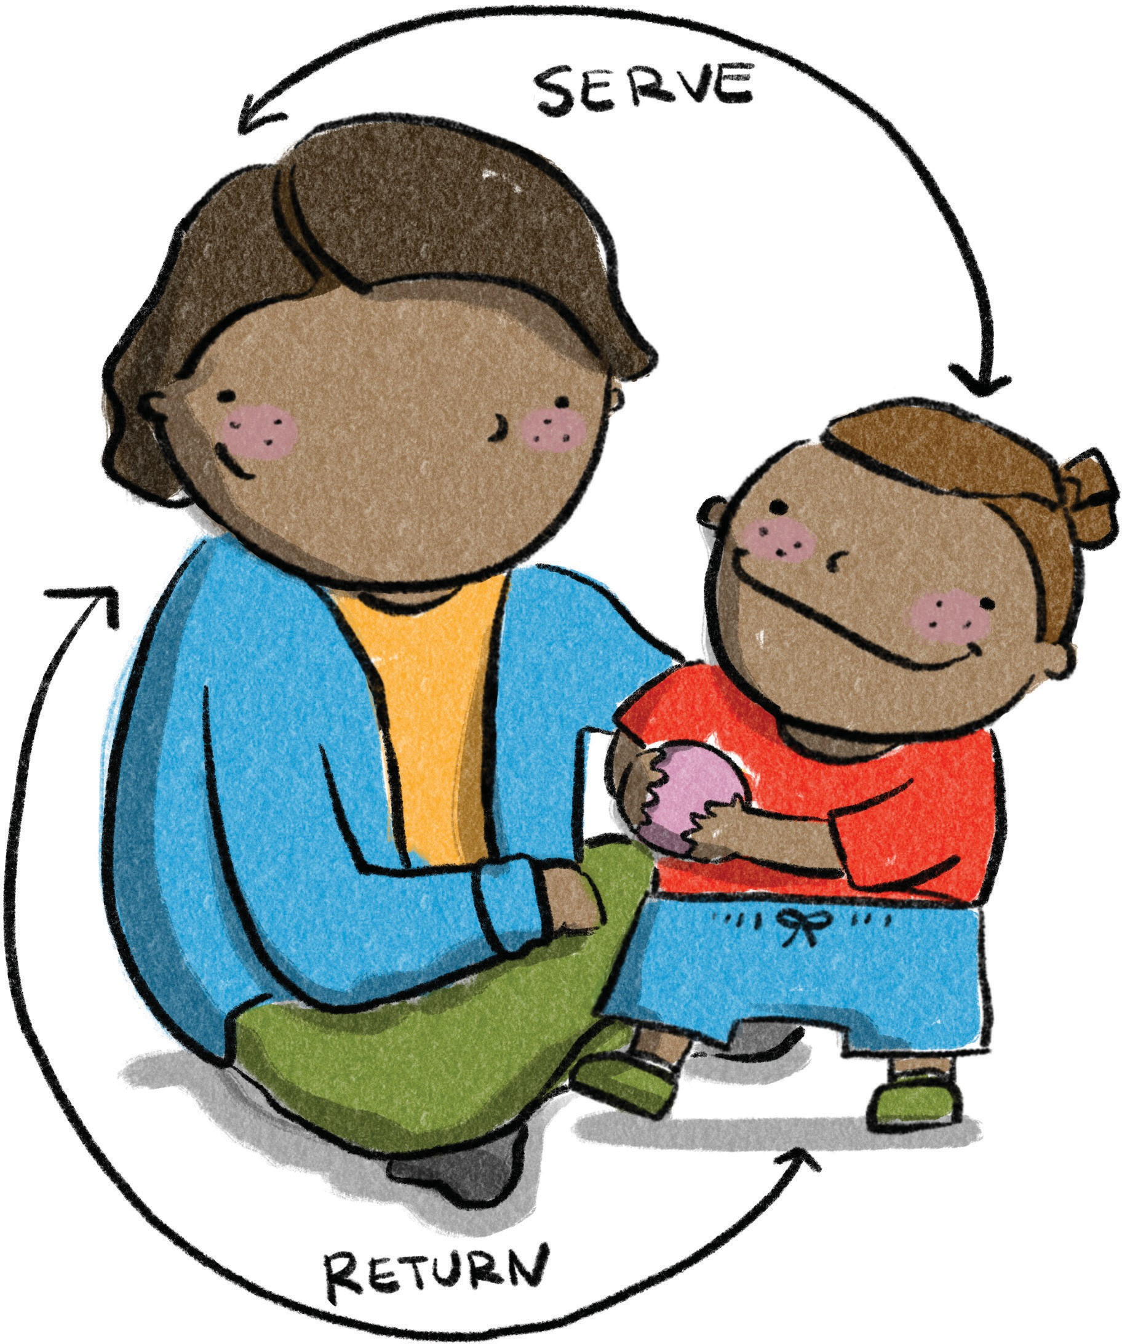


Message Nine
Serve and Return
Serve and return interactions don’t always need words. Lots of serve and return can be
non-verbal.
Serve and return interactions provide experiences and practice to build language, social, emotional, and
self-regulation skills, which provide a secure base to explore the
world, learn,
and grow.
Notes:
Facilitator Content
Serve and return refers to the everyday interactions between a baby or child and a parent or caregiver (or another child).
These interactions build brains, promote connection, develop responsive relationships, and develop communication and language skills, leading to the development of literacy skills.
When a baby or child sends a signal – like a cry, a body movement, a smile, a gesture, a touch, a sound, a word, or a comment – that is a serve.
When the adult responds with interest – like making eye contact, smiling back, copying the action or sound, making a comment, naming what they are seeing, feeling, doing or experiencing – that is a return.
These interactions don’t always need words, and they build brains by helping babies develop trusting and secure relationships, cope with stress, manage feelings, and learn new knowledge and skills.
When a baby serves and no one returns repeatedly, this can impact their brain development, reduce their communication attempts and delay their language development. About a 50% response to their serves is enough to develop a secure base for most babies.
Serve and return interactions can also help repair the impact of toxic stress or trauma in children.
Activity – Serve and Return
(see Facilitator’s Guide)

Slide 10
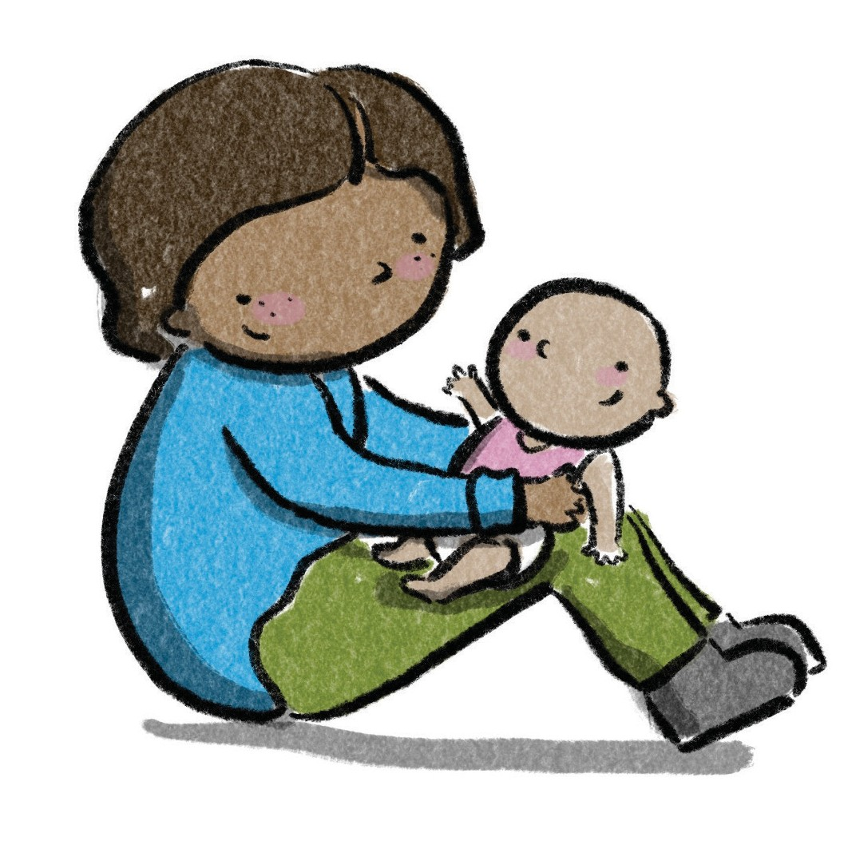
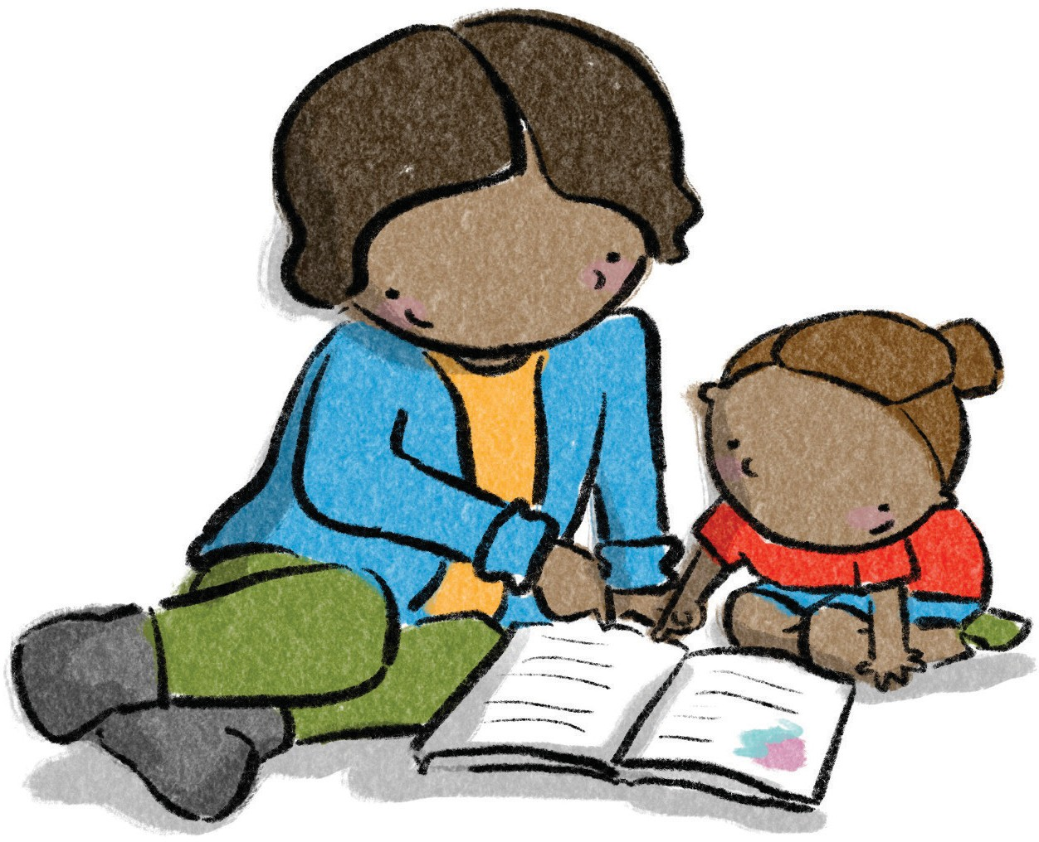
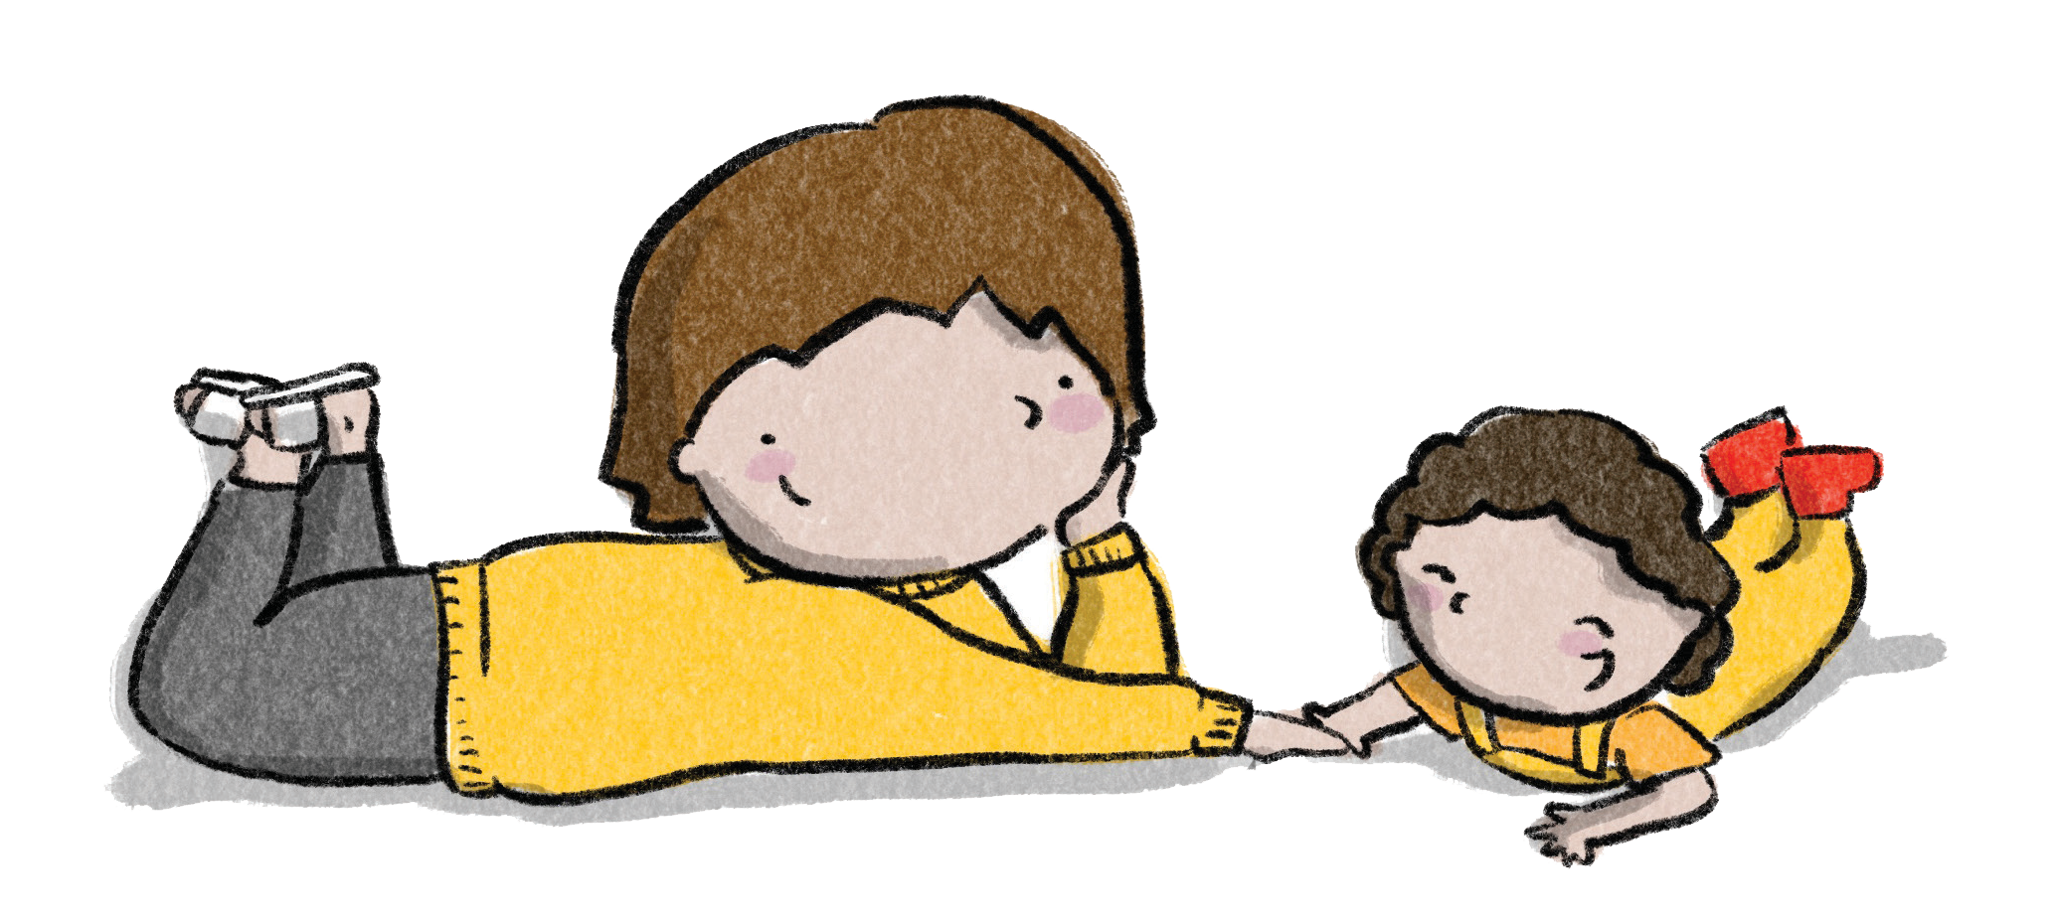
Message Ten
How Communication Grows
Notes:
Facilitator Content
When we interact face to face with babies and young children, paying attention to their body language and sounds, we create many opportunities for serve and return conversations.
Regular verbal serve and return conversations between caregivers and children, using a variety of different types of words, including action words, naming words and describing words, helps to develop strong language skills.
Children in environments with responsive conversations tend to learn a wider variety of words and concepts, which leads to better reading and writing skills.
Remember that children can understand sentences that are one or two words longer than what they use themselves. If a child is only speaking in 1-2 word sentences, they can only follow sentences that are 2-4 words long. Complicated sentences can cause communication frustration, as young children cannot hold them in their minds for long enough to process.
Adults can adjust and simplify their sentence length to slightly above a child’s level, depending on their interest and communication ability, to keep the conversation going.
The more serve and return interactions a child has, the more their language and social skills grow, strengthening communication pathways.

Slide 11

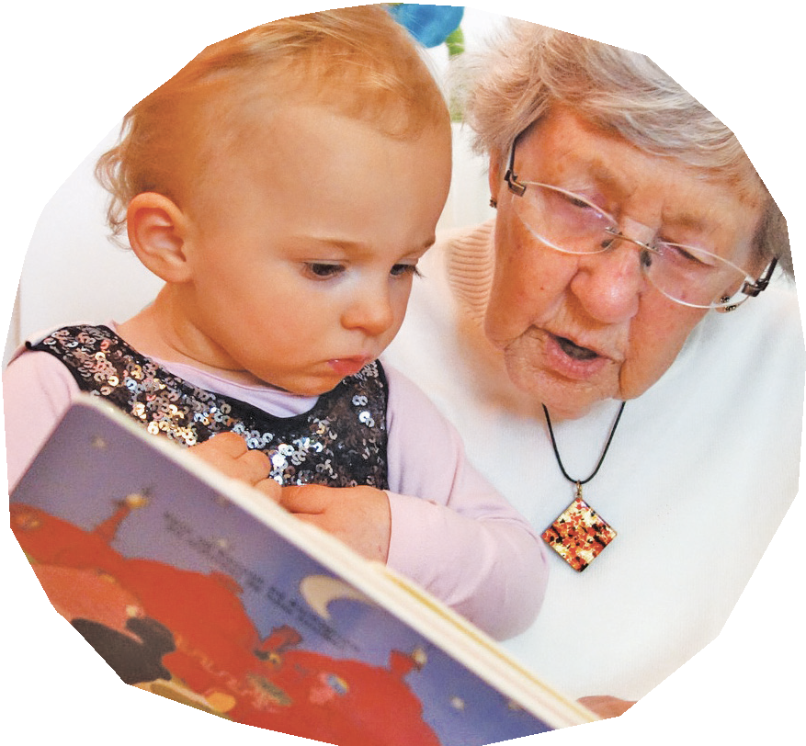


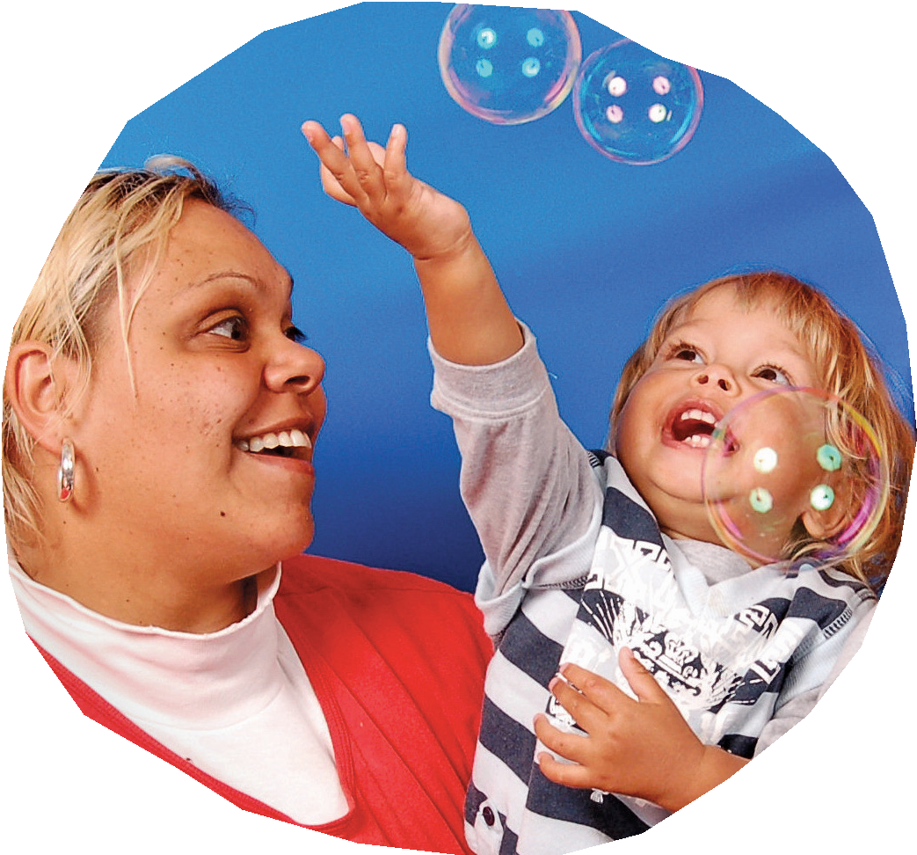

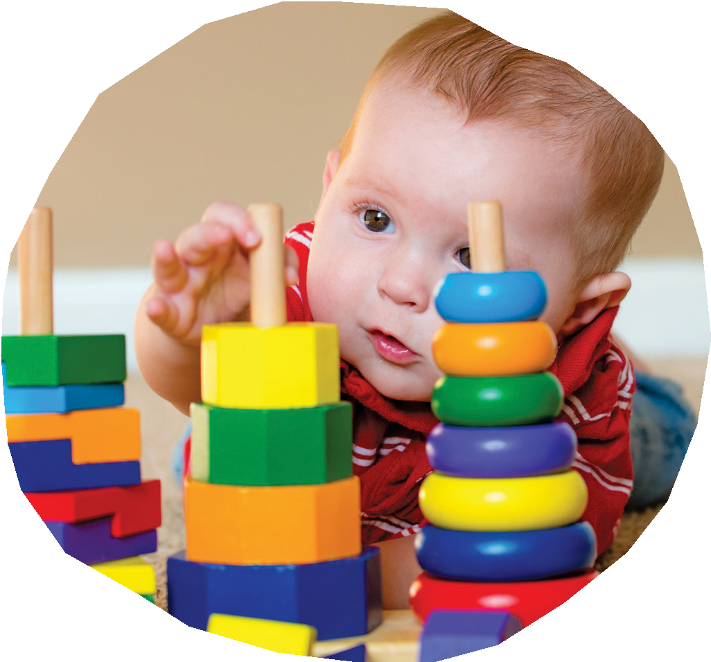

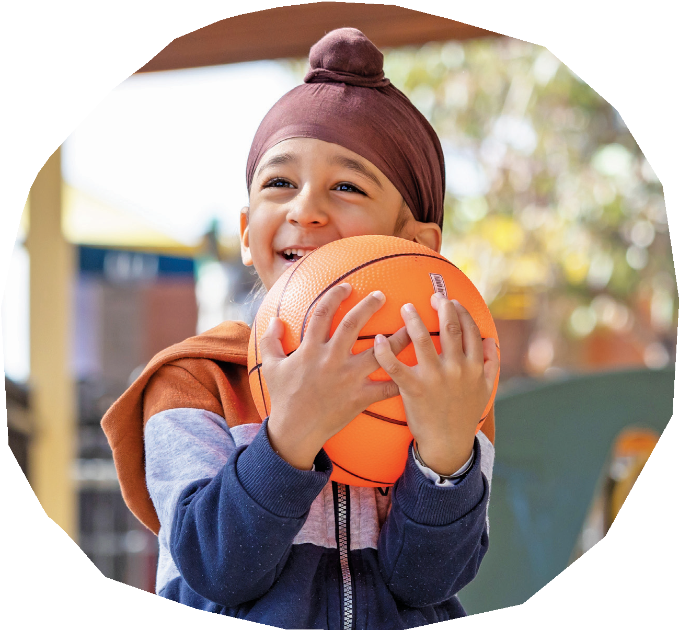
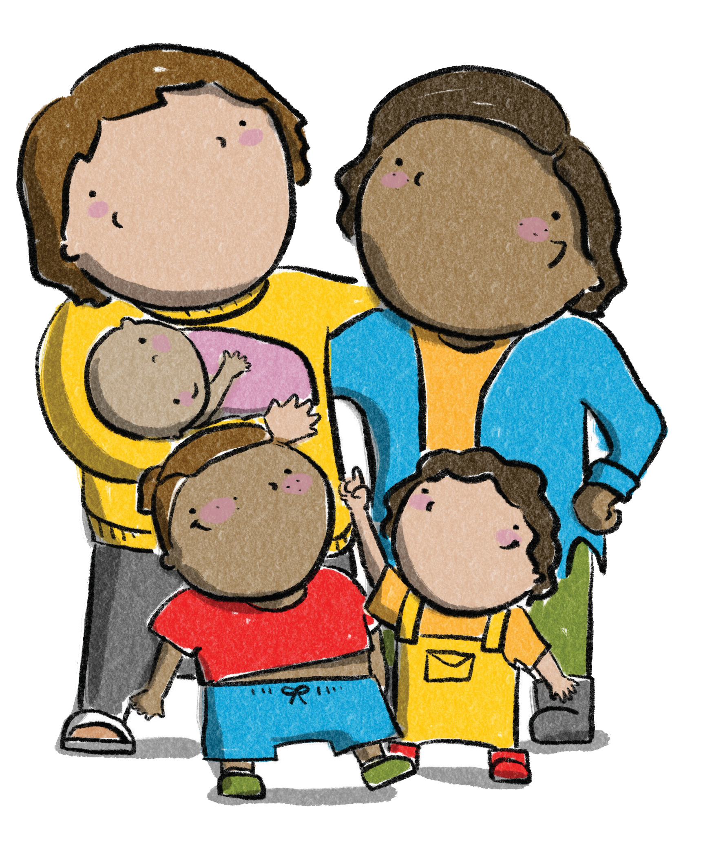

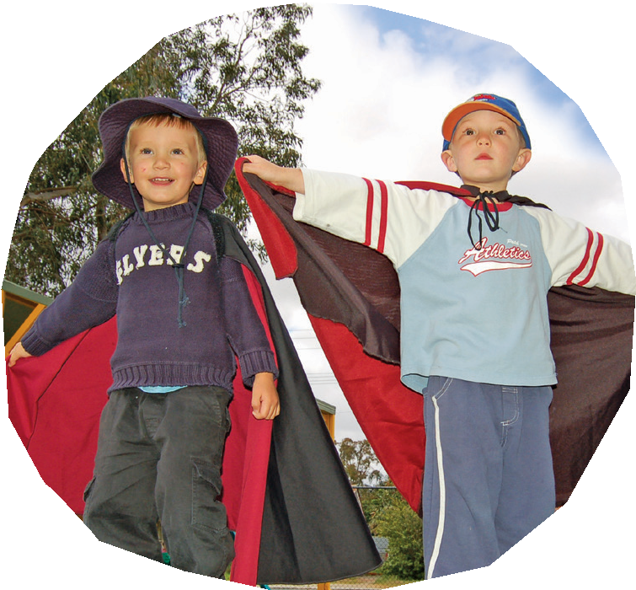

Message Eleven
Play is Powerful
Play is powerful - it builds brains as babies and children learn and develop
skills while having fun!
Play is an essential part of learning.
Engage children in playful activities that help develop their curiosity, creativity, and problem-solving skills.
Notes:
Facilitator Content
Play is essential for brain development in young children. Research has shown that play helps to promote the development of neural pathways in the brain, which are important for learning, memory and problem-solving.
Through play, children learn about themselves and their world, how to manage their bodies, their emotions, their thinking and their relationships.
During play, children engage in activities that stimulate their brain and promote the growth of new neural connections. For example, playing with blocks can help develop spatial awareness and problem-solving skills, while pretend play, such as acting out experiences with dolls or toy animals or role playing with other children, helps develop language and social skills.
Play also helps to promote the development of executive function skills, which are important for self-regulation, attention and goal-directed behaviour. Through play, children learn to regulate their emotions, focus their attention and plan their actions.
The type of play that children engage in can also have an impact on brain development. Research has shown that play that is open-ended and child-directed, such as free play and imaginative play, is particularly beneficial for brain development. They get to test out their ideas about the world and practice mastery of skills. This type of play allows children to explore their environment and use their creativity and imagination, which promotes the development of new neural connections.
Children thrive when they have lots of opportunities to play in different ways and with different play partners. They need adults to help with this. Adults help children learn and grow when they set the scene for great play ideas or help the child with their own plans. Asking questions or taking on roles in the child’s play helps build their confidence, social and language skills. Providing experiences where they can explore, discover different environments and mix with other children, provides the opportunities children need to build bodies and brains through play.
Activity – Learning through Play
(see Facilitator’s Guide)

Slide 12
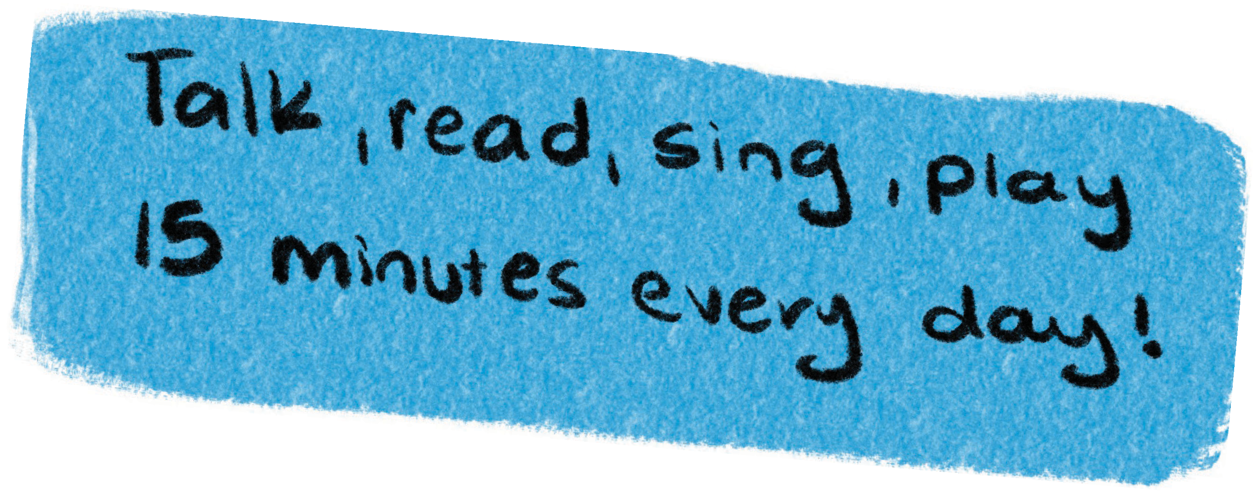
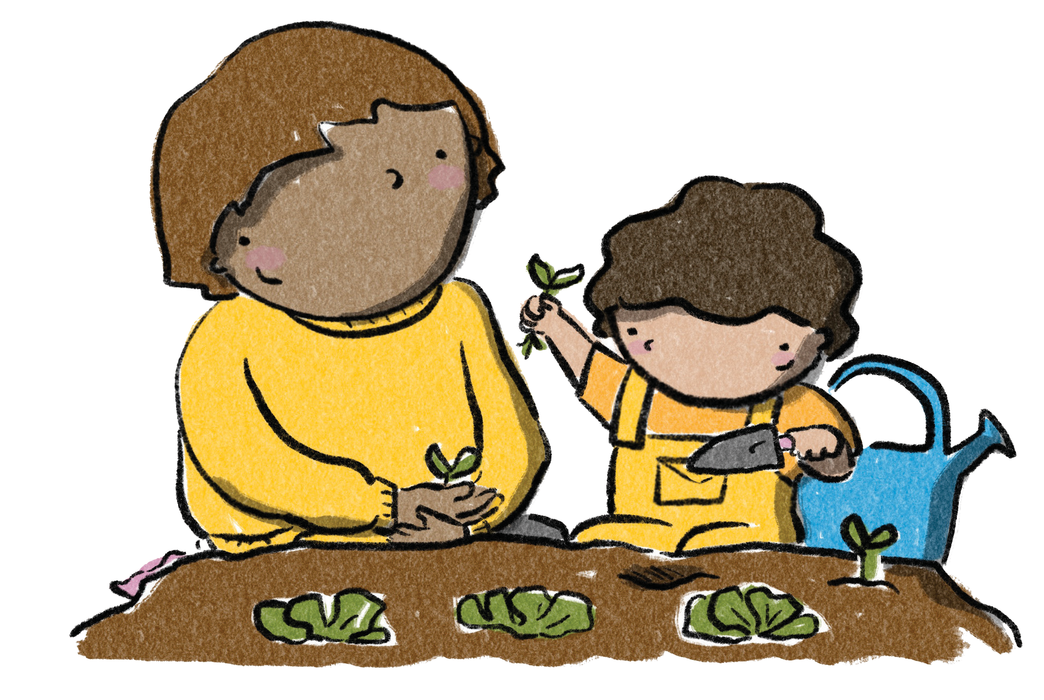

Message Twelve
Learning Everywhere
Learning can happen anywhere and anytime, not just in traditional educational settings.
Encourage children to explore and learn from the world around them.
Children learn best when they feel safe, loved and supported. Create a nurturing environment that promotes positive relationships and a sense of belonging.
Notes:
Facilitator Content
Having positive experiences and building real-world relationships during a child’s early years is crucial for their learning, health and behaviour throughout life, much more than the virtual world can offer.
A child’s positive stimulation comes from using all of their senses and engaging in talking, playing, singing, watching, listening, exploring and experimenting with new things.
A simple activity like reading a book with a child makes them feel safe, loved and secure, while developing emotional maturity, communication and general knowledge. It also develops their interest in reading and early literacy which supports their cognitive skills. If they share the experience with other children, they are also enhancing their social skills. If they act out parts of the story, draw or make something related to the story, they are developing their physical skills.
Technology can be a useful tool to enhance learning, but relying on it exclusively can take time away from other activities that are great for development. Balance screen time with other activities that promote physical activity, social interaction and creative expression.
Activity – Learning Everywhere
(see Facilitator’s Guide)

Slide 13



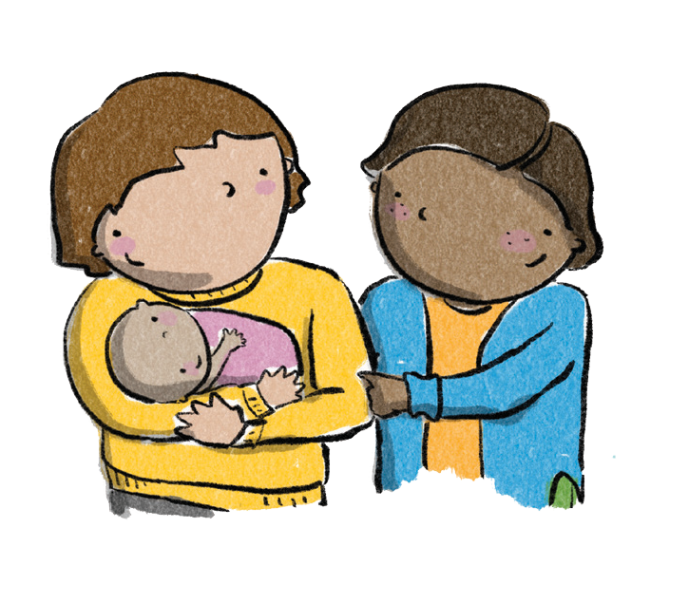

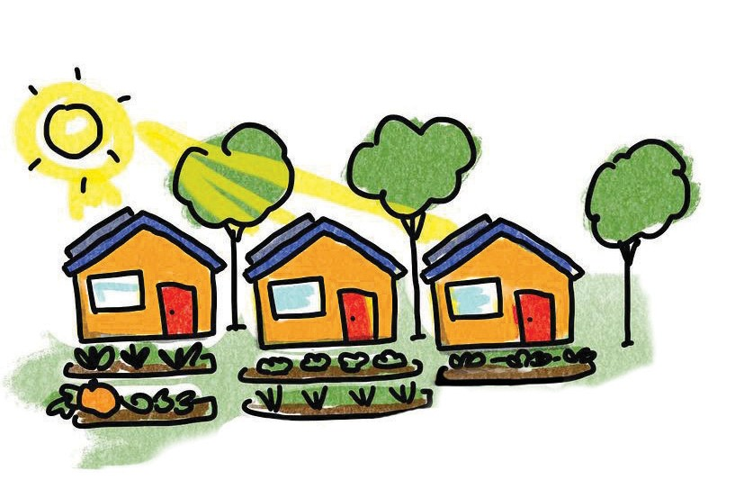


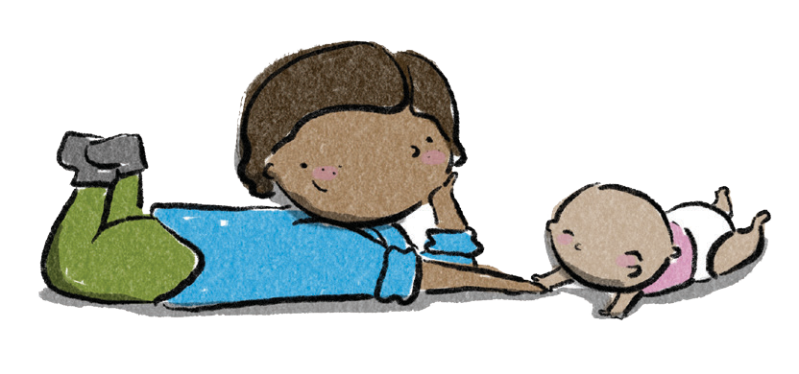
Brain Box Summary
Children develop in the context of responsive,
safe and secure relationships.
It’s not just families, but also the wider community, that supports healthy child and brain development.
While genetics provides the blueprint for a baby’s brain development, it’s the everyday experiences and relationships that shape
a child’s brain.

